Slide 1
Advanced Accelerator Lab at BNL ATF (PHY542)
By Mikhail Fedurin
01/23/2023

Slide 2
CASE
AAL course
  Syllabus
  Grading
Advanced Acceleration Concepts
ATF

Slide 3
CASE
CASE – The Center for Accelerator Science and Education has been established established as a Type I Institute within the University on November 19, 2008 as a Joint venture of BNL and SBU
  To train scientists and engineers with the aim of advancing the field of accelerator science;
  To develop a unique educational program providing access to accelerators
  To expand interdisciplinary research programs that utilize accelerators
The Stony Brook University / BNL connection provides an ideal educational environment. The close proximity to BNL and the BSA connection provides for a superb combination of both university and national laboratory environment.

Slide 4
Advanced Accelerator Laboratory Overview
The purpose of this course is to introduce the fundamentals of beam physics via experimental investigation on scaled experiments employing electrons beams.
The course is intended for graduate students and advanced undergraduate students who want to familiarize themselves with principles of accelerating charged particles and gain knowledge about contemporary particle accelerators and their applications.

Slide 5
Instructors
Prof. Mikhail Fedurin
Prof. Dmitry Kayran
Prof. Irina Petrushina
Prof. Yichao Jing

Slide 6
Learning Goals
The course will cover a wide array of the measurements and manipulations that are needed for beam dynamics studies. Upon completion, students are expected to understand the basic principles and relations of beam dynamics, many of which they will have experimentally verified. Furthermore, they will have gained experience in measurement techniques and analysis of experimental observations.
While emphasis will be given on experiments, it will also offer exposure to the latest accelerator computer simulation techniques.

Slide 7
Major topics
beam source physics
magnet measurements
optical imaging and processing using both fast and integrating devices
phase space mapping and emittance measurement
longitudinal dynamics and energy spread, beam control

Slide 8
Core of scientific experiment
Theory
Modeling
Experiment

Slide 9
Course Procedure
Introduction theory (30 min)
Experiment demonstration
(2 hr)
Modeling
(2 hr)

Slide 10
Textbook and suggested materials
“The Theory and Design of Charged Particle Beams” by Martin Reiser, published by Wiley (1994)
“Fundamentals of Beam Physics” by James Rosenzweig, published by Oxford 2003
“Classical Electrodynamics”, third edition, by J.D. Jackson, published by Wiley (1999). Chapters 11 and 12 are of particular relevance to this course.
Accelerator Physics, by S. Y. Lee

Slide 11
Grading
Students will be evaluated based on the following performances:
20% active participation in class
60% lab report preparation
20% report presentation
There will be no final exam.

Slide 12
Course schedule Spring 2023
1 | Mon, Jan 23 | Introduction class | This class will take place at SBU P117. All remaining classes will be at BNL
2 | Mon, Jan 30 | ATF safety overview, administrative issues, tour at ATF
3 | Mon, Feb 06 | Modeling photo-injectors, Introduction to ASTRA Computational HW1 | ATF Photoinjector Quantum efficiency measurements
4 | Mon, Feb 13 | Beam Acceleration Computational HW2 | Operation of radio-frequency cavities, phase-dependence
6 | Mon, Feb 20 | Advanced acceleration topics #1. Beam Diagnostics, emittance measurement techniques Lecture | Operation of position monitors; beam profile monitors; energy analyzer; emittance measurement with a BPM scan
7 | Mon, Feb 27 | Beam dynamics simulations Lecture and QA, Computational HW2, HW3 | ATF computer Lab
8 | Mon, Mar 06 | SpriBeam Diagnostics, emittance measurement techniques Lecture | Emittance measurement with Quad magnet scan
9 | Mon, Mar 13 | Spring Recess (no class)
10 | Mon, Mar 20 | Dispersion and Masking Techniques Lecture | Beam masking techniques and bunch-train production
11 | Mon, Mar 27 | Advanced acceleration topics #2 TBD. | Demonstration of production of sub-femtosecond pulses and longitudinal profile measurements
12 | Mon, Apr 03 | Bunch compression; Coherent Synchrotron Radiation (CSR);PHY542 2016 CSR_ATF2] | CSR effects on energy spread demonstration (ATF control room or/and comp. lab. using elegant)
13 | Mon, Apr 10 | Data Acquisition: Students Ex1: Photo cathode QE characterization. | Data Acquisition: Students Ex2: Solenoid scan. 4xBPM Emittance measurements.
14 | Mon, Apr 17 | Advanced acceleration topics #3 TBD | Magnetic measurements (To be confirmed)
15 | Mon, Apr 24 | Data Acquisition: Students Ex3: RF linacs phase optimisation. Emittance measurements | Data Acquisition: Students Ex4: Beam masking techniques
16 | Mon, May 01 | Finals: Student presentations
17 | back up | Transport of particle beams, magnets Lecture PHY542 2016 Magnets | Magnetic measurements. Finishing Simulation in Comp. Lab HW1, HW2, HW3, HW4

Slide 13
Safety at ATF
All students must complete online general training “Guest Site Orientation” (TQ-GSO).
In addition, here is the list of online ATF - specific training that you should also take prior to your arrival at ATF:
- Static Magnetic Fields
- LOTO Affected (Awareness)
- ATF Awareness
Note:
- Any student with medical conditions/implants affected by magnetic fields needs medical clearance prior to entry into exp hall or work with magnetic measurements.

Slide 14
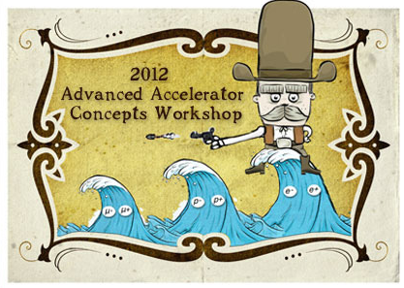
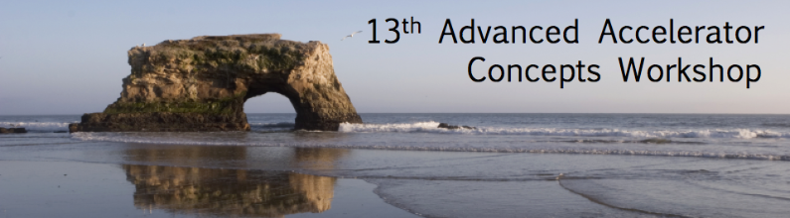
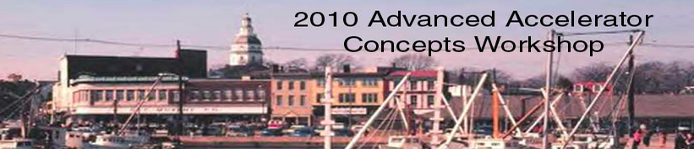




Advanced Acceleration Concepts

Slide 15
Advanced Acceleration Concepts
Laser-Plasma Wakefield Acceleration
Computations for Accelerator Physics
Laser and High-Gradient Structure-Based Acceleration
Beam-Driven Acceleration
Beam and Radiation Generation, Monitoring, and Control
Laser-Plasma Acceleration of Ions
Muon Colliders and Advanced Concepts
Laser Technology for Laser-Plasma Accelerators​

Slide 23


Wakesurfing
surfing
wake
Notes:
It’s easy to understand
Is surfing on a wake
Don’t necessarily move quicklly
Skilled surfer
Important question
Wake transfers energy

Slide 24
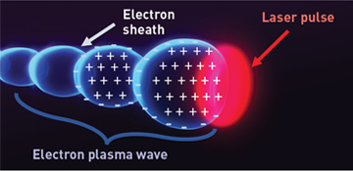

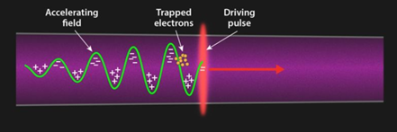
Laser wakefield acceleration
Ocean → Plasma
Boat → Laser pulse
Surfer → Electrons
10 – 20 microns
(<1/3 hair)
World record
8 000 MeV in 0.2 m
(40 000 MeV/m)
(compare ≤25 MeV/m)
Notes:
Bunch of electrons
Plasma is a gas of
Train of bubbles, engine
Gets inside - Cannot escape
Proof-of-principle lab demo
Many difficulties

Slide 25
… with a CO₂ laser
Laser
200 microns
(>3x hair)
Long wavelength →
Low optimal plasma density →
Large wake →
Large charge & high brightness
Notes:
CO2 comes to the rescue
Long wavelength – Large wakes
10x larger bubbles
Easier to deal with
1000x volume
1000x more electrons

Slide 27
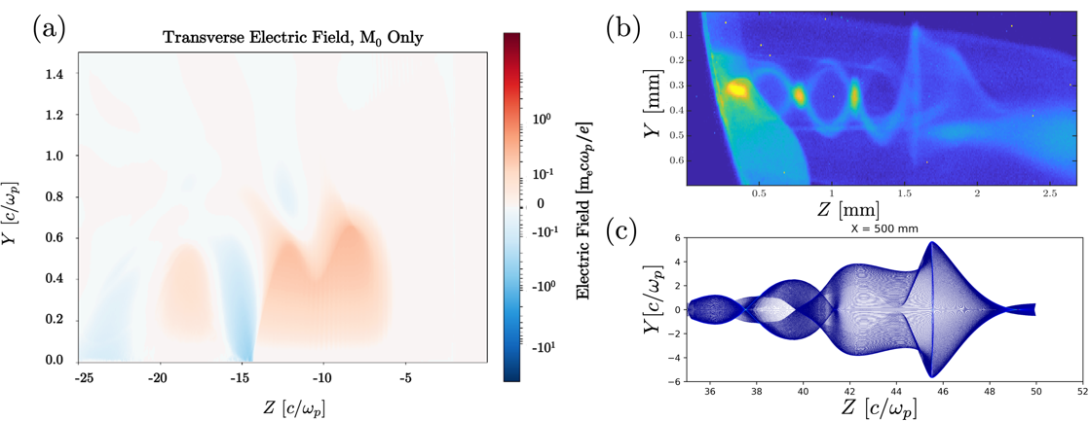
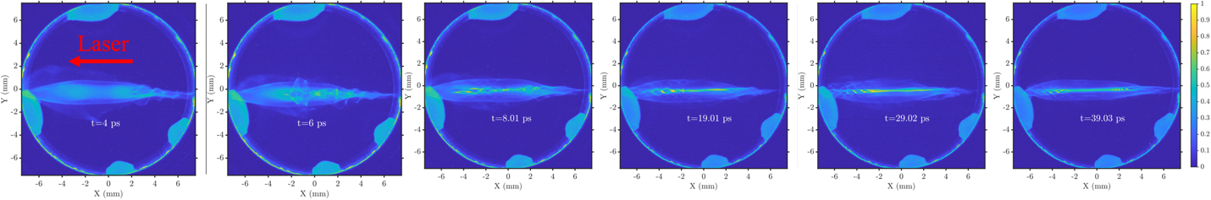
Summary of major results (AE93 past years)
a) Transverse electric field distribution of the excited wake obtained using OSIRIS;
(b) Experimentally captured image of the e-beam passing through an excited wake ~5.6 ps after the CO₂ has entered the RI;
(c) e-beam probe simulation results obtained 50 cm away from the IP.
E-beam images capturing the time-evolution of the excited wake at plasma densities ~10¹⁷ cm⁻³.
BS student, Marisa Petrusky, has graduated in 2021 with the thesis titled “PICTURING PLASMA: STUDYING THE SIMULATED TRANSVERSE PROBING OF LASER WAKEFIELD ACCELERATORS”

Slide 28
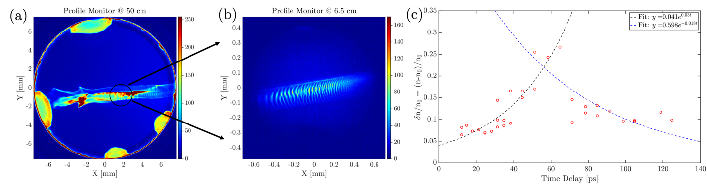
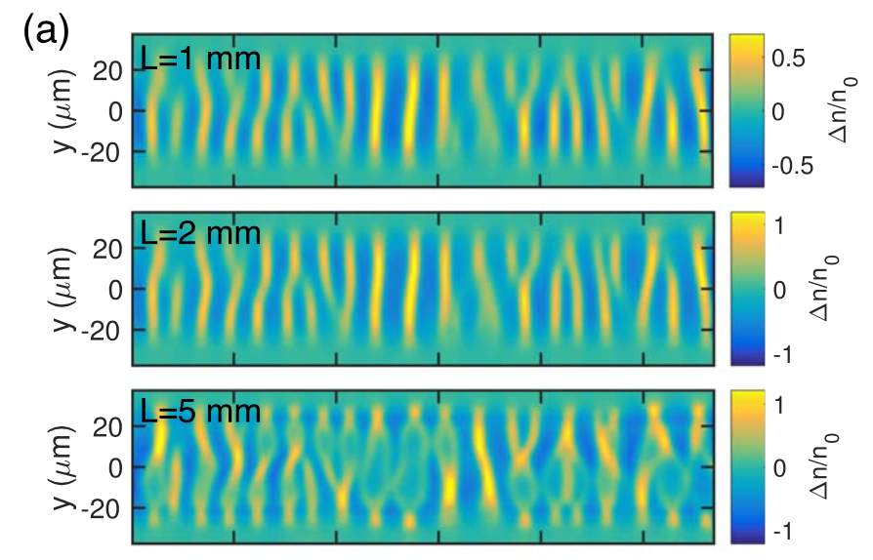
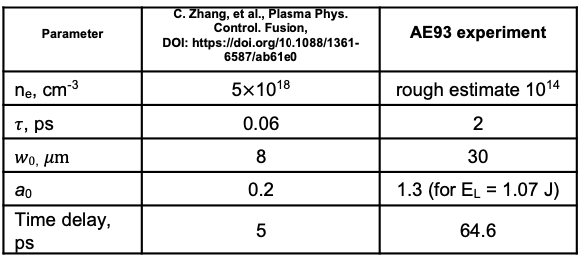
Summary of major results (AE93 past years)
Experimentally obtained images of the e-beam probe at (a) 50 cm and (b) 6.5 cm at the densities of ~10¹⁴ cm⁻³. The black circle indicates the region of the wake observed at the movable screen. (c) e-beam density modulation as a function of time delay.
Simulations
Experiment
^{Parameter} | C. Zhang, et al., Plasma Phys. Control. Fusion, DOI: https://doi.org/10.1088/1361-6587/ab61e0 | ^{AE93 experiment}
n_{e}, cm⁻³ | 5$×$10¹⁸ | rough estimate 10¹⁴
$τ$, ps | 0.06 | 2
$w0$, $μm$ | 8 | 30
a₀ | 0.2 | 1.3 (for E_{L} = 1.07 J)
Time delay, ps | 5 | 64.6
L = 6.5 cm
Laser

Slide 31
Accelerator Test Facility
Brookhaven National Laboratory

Slide 35
ATF layout

Slide 36
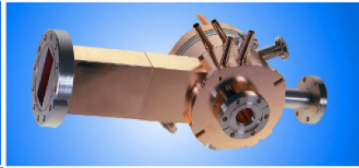
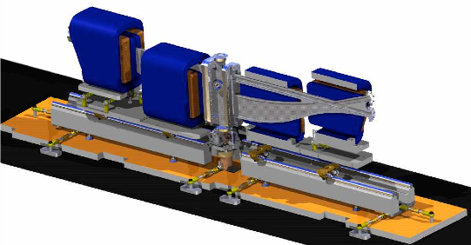
Main beam parameters
Parameter | Typical value / range | Best value
Energy | 30-80 MeV | 80 MeV
Charge | 0.1 – 1 nC | 3 nC
Repetition rate | 1.5 Hz | 10 Hz
Electron spot size on cathode | 2.86 mm | 0.2 – 4 mm
Bunch length | 1-8 ps | 100 fs with compression
Average bunch current | 100 A | 1.5 kA with compression
Emittance | 1 – 3 mm mrad | 0.8 mm mrad @ 0.5 nC

Slide 38
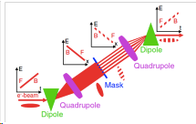
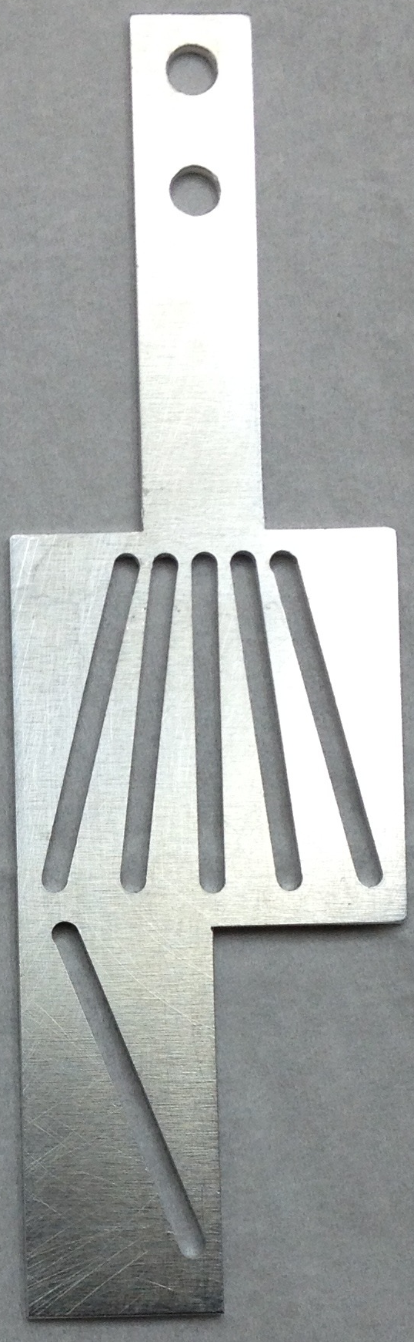
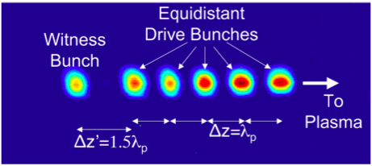
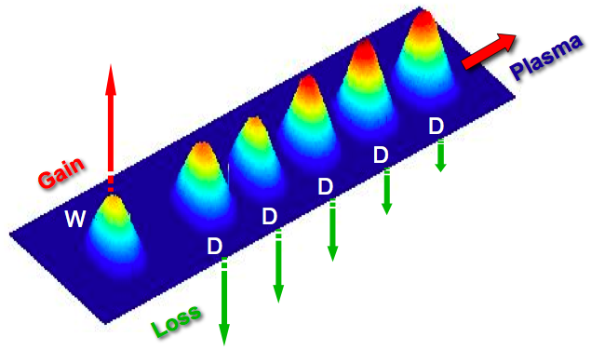
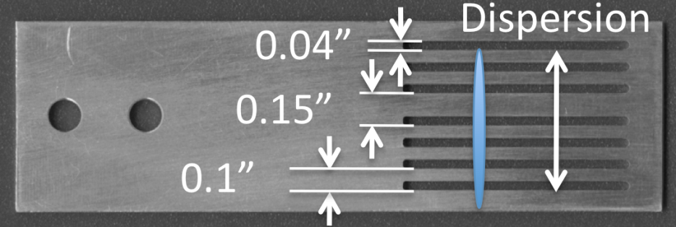
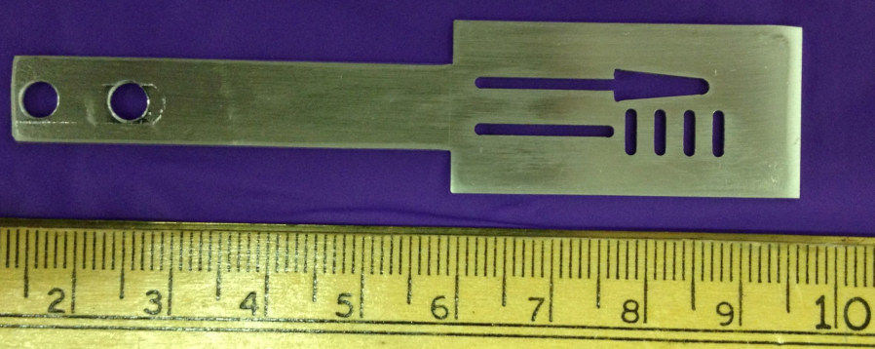
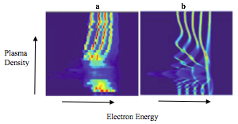
Beam capabilities: mask techniques
bunch current 100 A
30 μm bunches
Muggli, P., et al., Simple method for generating adjustable trains of picosecond electron bunches. Physical Review Special Topics-Accelerators and Beams, 2010. 13(5): p. 052803
Muggli, P., et al., Generation of trains of electron microbunches with adjustable subpicosecond spacing. Phys Rev Lett, 2008. 101(5)

Slide 39
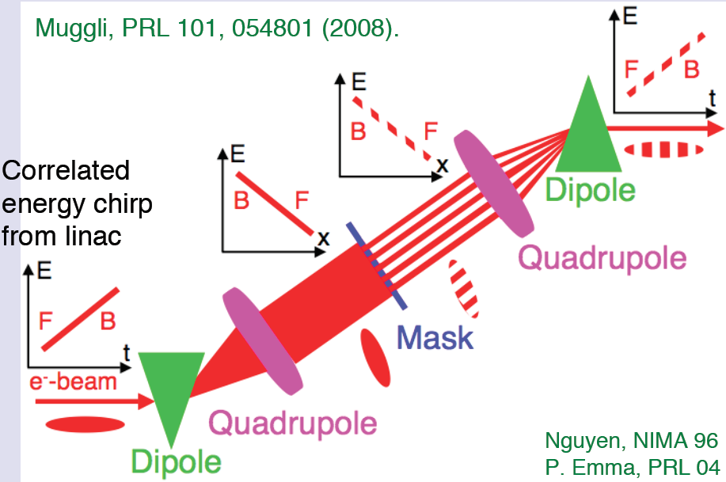
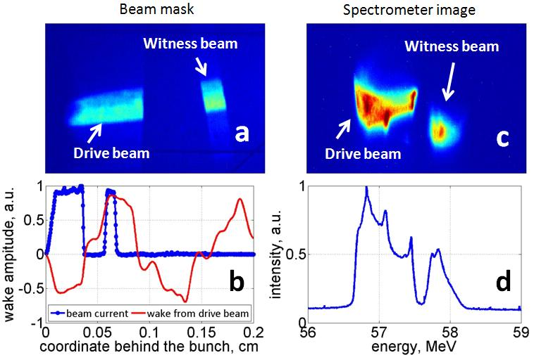
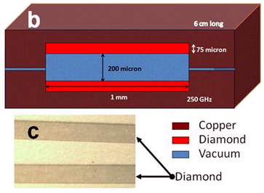
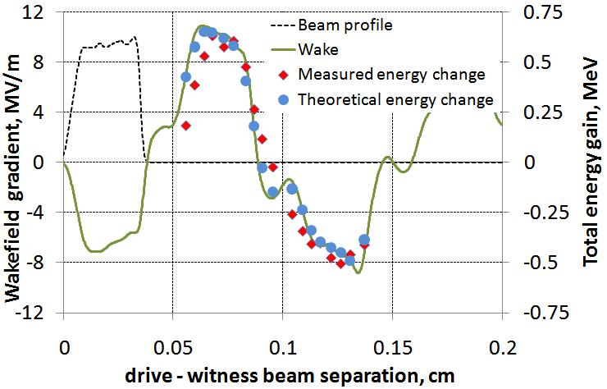
Mask technique: Wakefield Mapping
S. Antipov, C. Jing, A. Kanareykin, J. E. Butler, V. Yakimenko, M. Fedurin, K. Kusche, and W. Gai, Appl. Phys. Lett. 100, 132910 (2012)
By courtesy of Sergey Antipov, Euclid

Slide 40
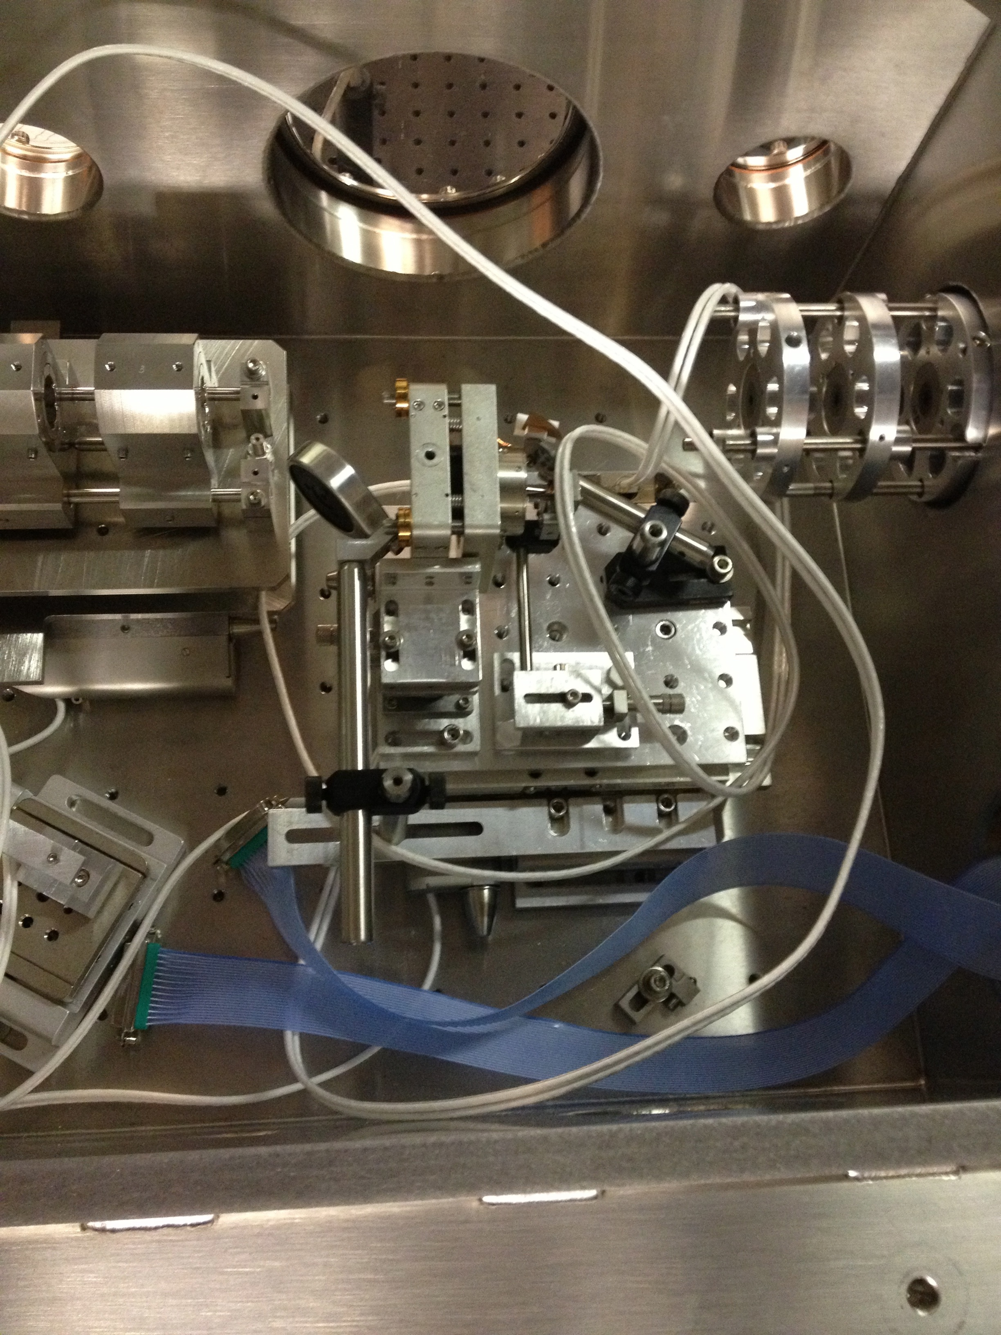
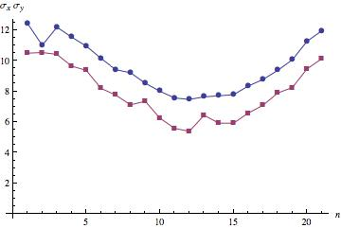
Beam capabilities: transverse size σ_{x,y} ~ 5 μm
Radiabeam PMQ triplet assembly:
K=50 T/m, triplet focal length ~20 cm
UCLA PMQ triplet assembly:
K=500 T/m,
triplet focal length ~8 cm
Microscope (25-0506 X15 Reflecting Objective NA 0.28, F~13 mm)
Basler Gigabit camera (scA 1400-17gm, F=135 mm).

Slide 42
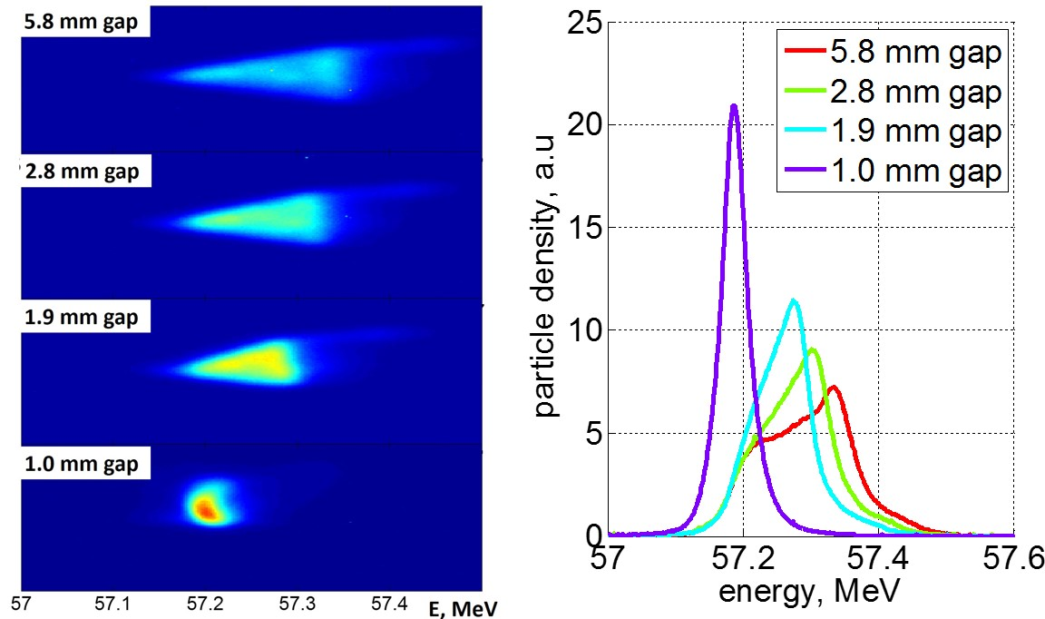
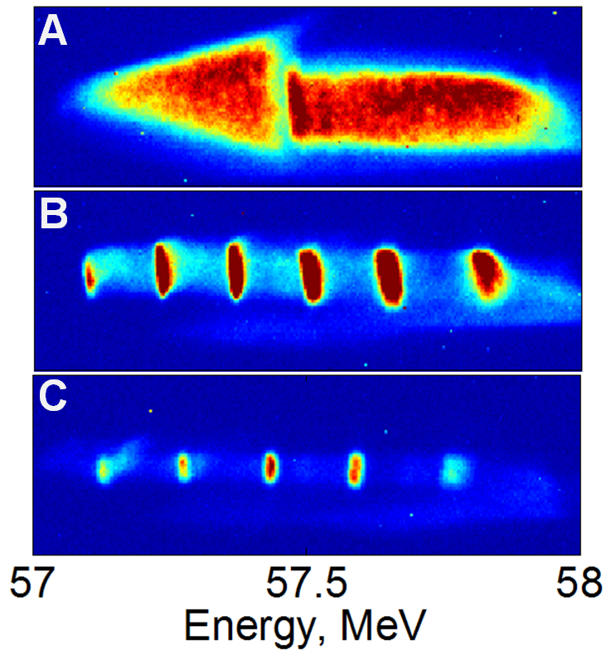
Diagnostics: spectrometer
Measurement: spectrometer
Original chirped beam
0.95 THz structure
0.76 THz structure
Triangular-shaped (current) beam with energy chirp Correlated energy spread was removed by closing the dechirper gap
Observation of energy modulation
S. Antipov, S. Baturin, C. Jing, M. Fedurin, A. Kanareykin, C. Swinson, P. Schoessow, W. Gai, and A. Zholents, Phys. Rev. Lett. 112, 114801 (2014)
S. Antipov, C. Jing, M. Fedurin, W. Gai, A. Kanareykin, K. Kusche, P. Schoessow, V. Yakimenko, A. Zholents, Phys. Rev. Lett. 108, 144801 (2012)
By courtesy of Sergey Antipov, Euclid

Slide 43
Thank you!

Slide 44
If anyone have transportation or time conflict problem to come to BNL, I’d recommend:
CASE course PHY543: “RF Superconductivity for Accelerators”
Scheduled on Mondays from 6pm to 9pm and will be mostly online or at this location
(MELVILLE LBR N3063 WESTCAMPUS)
http://case.physics.stonybrook.edu/index.php/RF_Superconductivity

Slide 45
ATF II upgrade

Slide 48
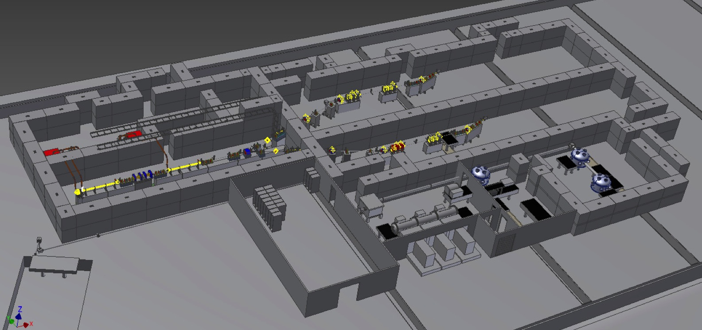
Perspectives: ATF2 upgrade

