Slide 1
CeC Theory
Developing Theoretical Tools for CeC
G. Wang
ICFA Mini-Workshop CeC 2019
July 24-26, 2019

Slide 2
The role of theoretical tools
Make predictions for an ideal/simplified system:
  Validate numerical simulations;
  Improve our understandings of the physical processes involved in CeC and if possible, obtain scaling laws;
Theoretical tools are often inadequate for accurate prediction of a realistic CeC system (requires numerical simulation).

Slide 3
Overall Structure of CeC Prediction
Ion’s initial condition
x, x’, y, y’, t, E
… … … … … …
… … … … … …
Kicks due to CeC
dx’, dy’, dE
… … … …
… … … …
A. Prediction of the single pass kicks received by an ion in the cooling section
Interpolation
B. Long term prediction for circulating ions
CeC
Ion bunch

Slide 4
Outline
Prediction of cooling force in a single pass
  FEL-based CeC system
  PCA-based CeC system
  Chicane-based CeC system / MBEC
Prediction of Au beam evolution in the presence of cooling
  Analytical approach: solving 1-D Fokker-Planck equation
  Comparison with macro-particle tracking
Future work and challenges

Slide 5
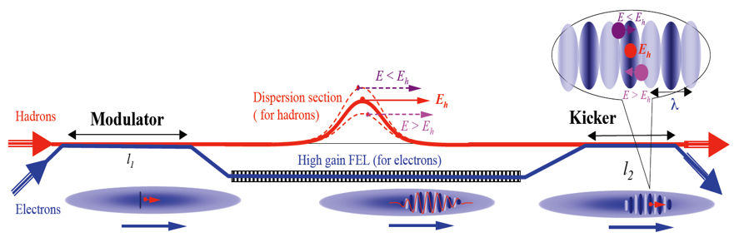
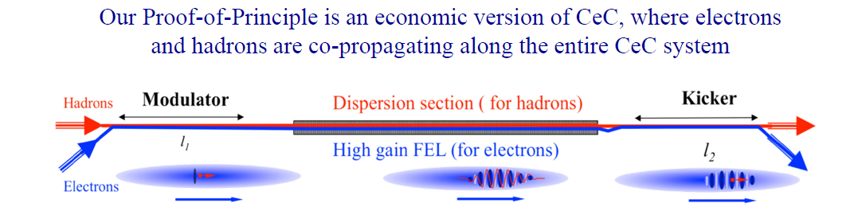
FEL-based CeC
The economical version is made possible by:
1. Use relatively weak undulator field to reduce the delay of electrons;
2.Wave-packet moves faster than electrons.

Slide 6
Parameters for the CeC PoP experiment
Electron beam parameters* (γ=28.6)
Peak current* | 40 A
Bunch length, (full length with uniform profile) | 25~30 ps
RMS emittance, normalized | 3~5 μm
RMS beam width at modulator/kicker | 700 μm
RMS beam width at FEL amplifier | 235 μm
RMS energy spread | 1e-3
System parameters*
Length of modulator/kicker | 3 m
Undulator period | 4 cm
Total number of undulator period (3 sections) | 188
Undulator parameter, a_{w} | 0.5
FEL optical wavelength | 30.5 μm
Pierce parameter, ρ | 0.012
* The designed peak current was changed to 75A to compensate FEL gain reduction due to longitudinal space charge

Slide 7
Analytical Tools for the Modulation Process I
Cold uniform electron beam (© V.N. Litvinenko)
  Density modulation:
  Energy modulation ( ):
Warm uniform electron beam with k-2 velocity distribution
  Density modulation:

Slide 8
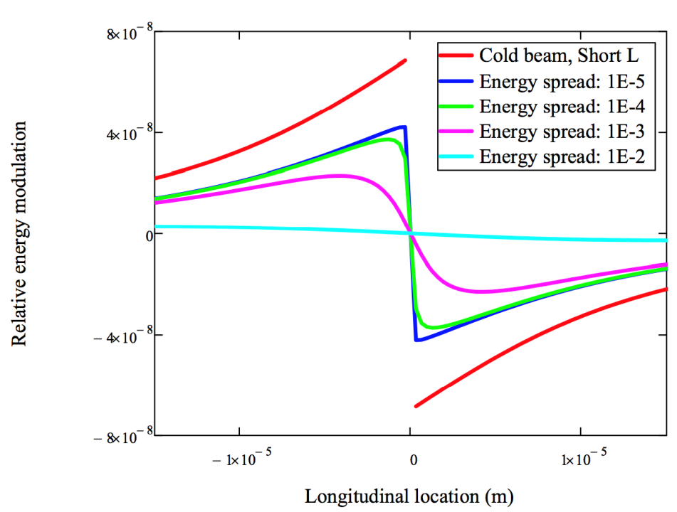
Analytical Tools for the Modulation Process II
  Energy modulation:
  where is an 1-D integral with finite integration limits (see backup slides).
It reduces to the previously derived cold beam result at the corresponding limits:

Slide 9
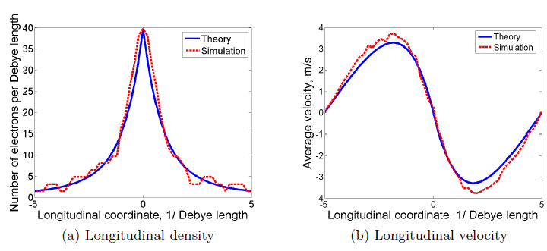
Validating Numerical Simulations with Theoretical Prediction
Simulations based on perturbative trajectory approach (© J. Ma, with code SPACE)
  Benchmarked with theory for uniform warm beam

Slide 10
Analytical Prediction for FEL Amplifier
For the CeC PoP parameters, the FEL amplifier works in the diffraction dominated regime
and hence we can’t rely on 1-D theory to predict the performance of the amplifier.
There are formulae to make corrections to the 1-D gain length for the general case developed by Ming Xie,
and using this number we get (for 40A peak current and 5 mm.mrad emittance)

Slide 11
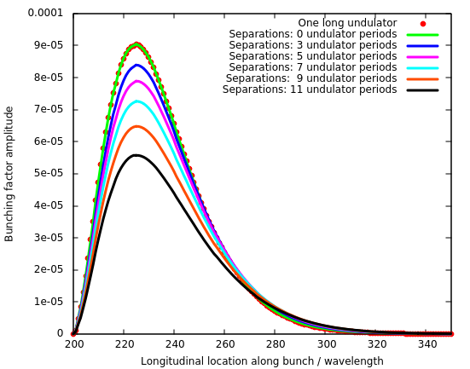
Effects due to multi-subsections
The radiation width
Rayleigh length
Only 17% of the radiation power propagates to the next subsection
Our undulator consists of 3 sub-sections and more than 80% of radiation power is lost in the 44cm gap between two successive subsections.

Slide 12
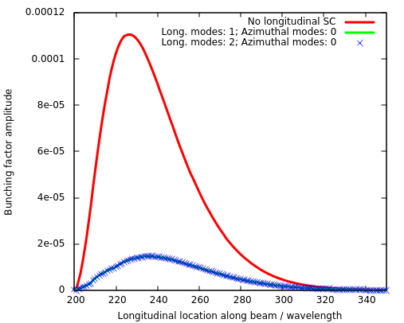
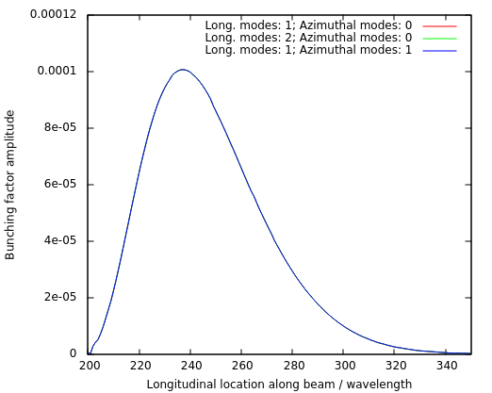
Effects due to Longitudinal Space Charge
Peak current: 75 A
Emittance: 8 um
Peak current: 51 A
Ion
Longitudinal space charge has more pronounced effects on the FEL gain than what to be expected from theory.

Slide 13
FEL Saturation
Using the saturating criteria that radiation power at saturation is
Using the criteria
* There is a factor of between the two estimates.

Slide 14
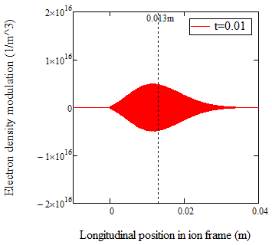
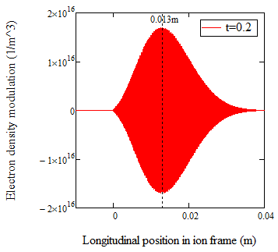
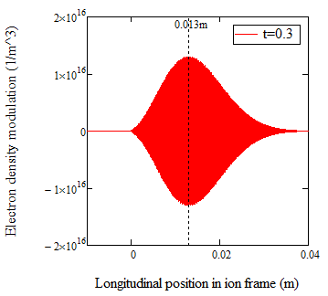
Analytical Tools for Kicker
Dynamic equation in Kicker is very similar to that in the modulator except the initial modulation in 6D phase space dominates the process. For 1D FEL output with the certain assumptions for the transverse distribution, the following analytical formula for density modulation can be derived

Slide 15
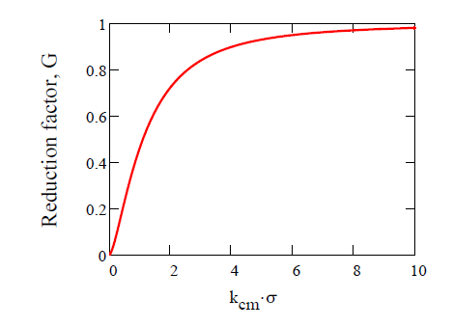
Field Reduction due to Finite Transverse Size
To estimate the reduction of electric field due to finite transverse size, we solve Poisson equation for charge distribution of the form:
and get the on-axis longitudinal electric field
For Gaussian transverse density distribution, we obtain
Lorentz
transform
Lab frame
Beam frame
We are here
*The results reproduces what previously derived by G. Stupakov.

Slide 16
Single-Pass Kick Received by an ion in FEL-based CeC section
Energy kicks from CeC is
Coherent kick induced by the ion itself
Incoherent kick induced by the neighbor ions (using the Gaussian profile as obtained by quadratic expansion of FEL eigenvalues)
Since there is no correlation between any successive incoherent kicks, one can use a random kick to represent the incoherent kicks
For a random number uniformly distributed between -1 and 1

Slide 17
Simulation tools for predicting the influences of CeC to a circulating ion beam II
Assuming the ion density does not vary significantly over the width of the wave-packet
The one-turn energy kick due to CeC is
Diffusive kick induced by neighbor electrons, i.e. electrons’ shot noise

Slide 18
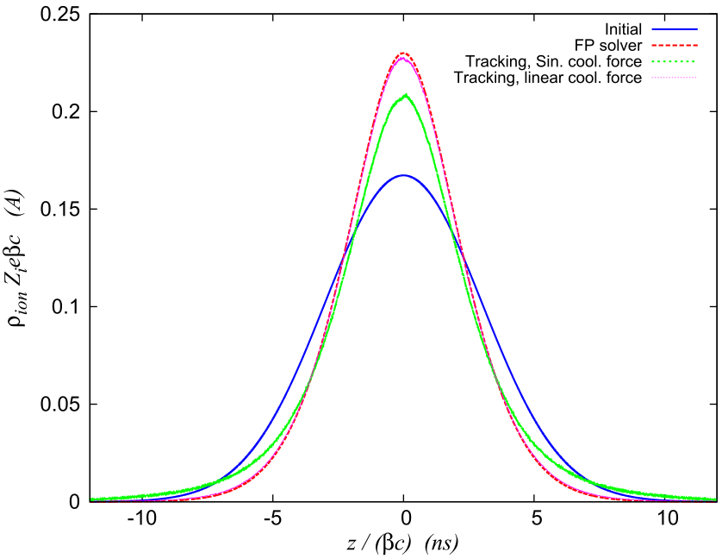
Applying Single-pass Kick to Predict Ion Beam Evolution with Cooling
Macro-particle tracking
Solving Fockker-Planck equation
40 minutes of cooling

Slide 19
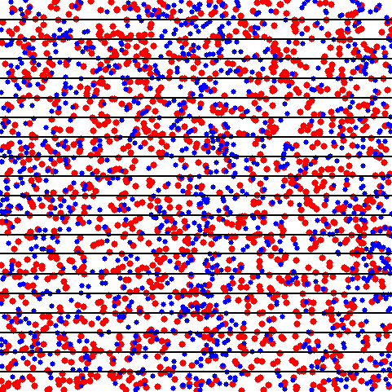
PCA-based CeC
Plasma-Cascade Instability
  Longitudinal plasma oscillation
Longitudinal plasma oscillation in a neutral plasma (from the internet, only for illustration)
Plasma oscillation also exist in single-species plasma like electron beam.

Slide 20
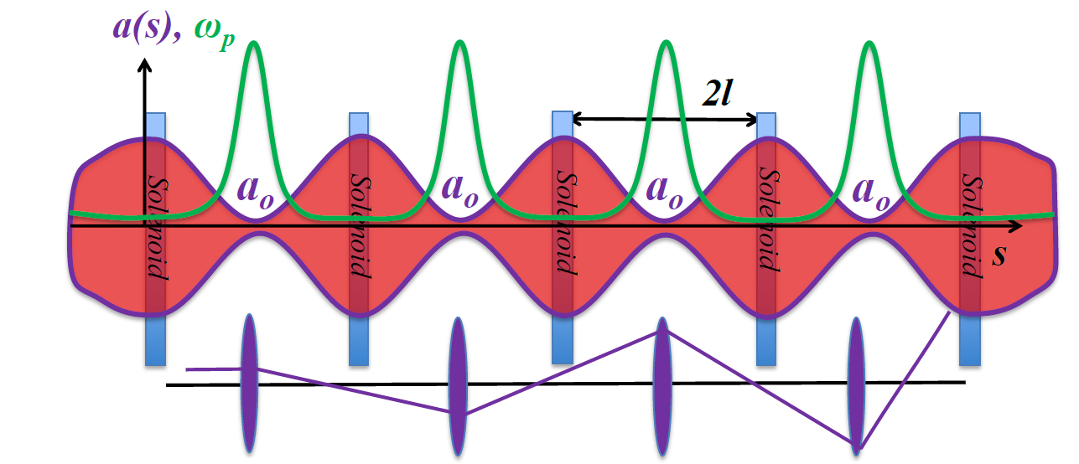
Plasma-Cascade Instability
Longitudinal plasma oscillation with periodically varying plasma frequency
Betatron motion in a FODO cell
Stability condition

Slide 21
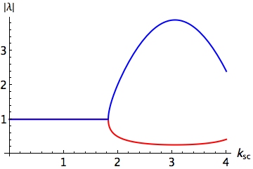
Analytical solution for emittance dominated beam
If we assume , the envelope equation become and its solution for initial condition of and is
and the equation of longitudinal density perturbation becomes
which can be solved in terms of Hypergeometric function:
The eigenvalues for the transfer matrix of one cell is

Slide 22
Gain of Plasma-Cascade Instability

Slide 23
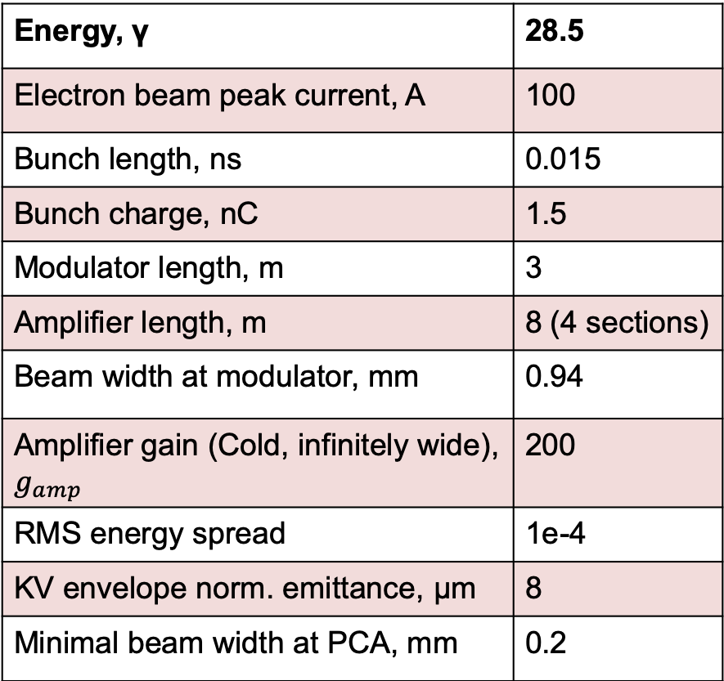
Estimate Cooling Force for PCA-based CeC: Parameters
Energy, γ | 28.5
Electron beam peak current, A | 100
Bunch length, ns | 0.015
Bunch charge, nC | 1.5
Modulator length, m | 3
Amplifier length, m | 8 (4 sections)
Beam width at modulator, mm | 0.94
Amplifier gain (Cold, infinitely wide), $g_{amp}$ | 200
RMS energy spread | 1e-4
KV envelope norm. emittance, μm | 8
Minimal beam width at PCA, mm | 0.2

Slide 24
Estimate Cooling Force for PCA-based CeC: Line density perturbation
Line density perturbation at the exit of the modulator:
Line density perturbation at the exit of the Plasma-Cascade Amplifier:
Gain reduction factor due to finite transverse beam size
Landau damping factor for Lorentzian energy distribution

Slide 25
Estimate Cooling Force for PCA-based CeC: Line density perturbation
Line density perturbation in wave-number domain
Line density perturbation in spatial domain

Slide 26
Estimate Cooling Force for PCA-based CeC: Longitudinal Electric Field in the Kicker Section
The electric potential induced by the line density perturbation is determined by the following equations
If we take the transverse distribution of the electrons as
The electric field can be solved as
For easy implementation into ion tracking code, we use the fitting formula:

Slide 27
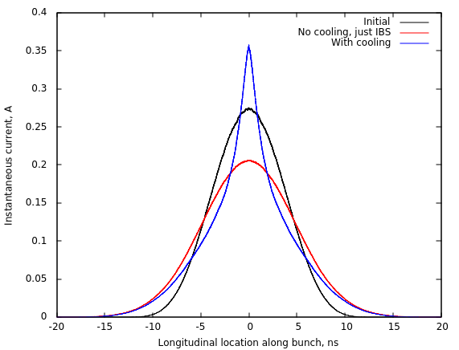
Single-pass Kick and Tracking Results for PCA-based CeC
Parameters used in ion tracking
E₀* | 62 V/m
σ_{c} | 3.75 μm
Z_{ion} | 79
Ion bunch intensity | 2E8
D (R₅₆) | 1.2 cm
*E₀ is reduced by a factor of 2 to account for reduced cooling for ions with large betatron amplitude

Slide 28
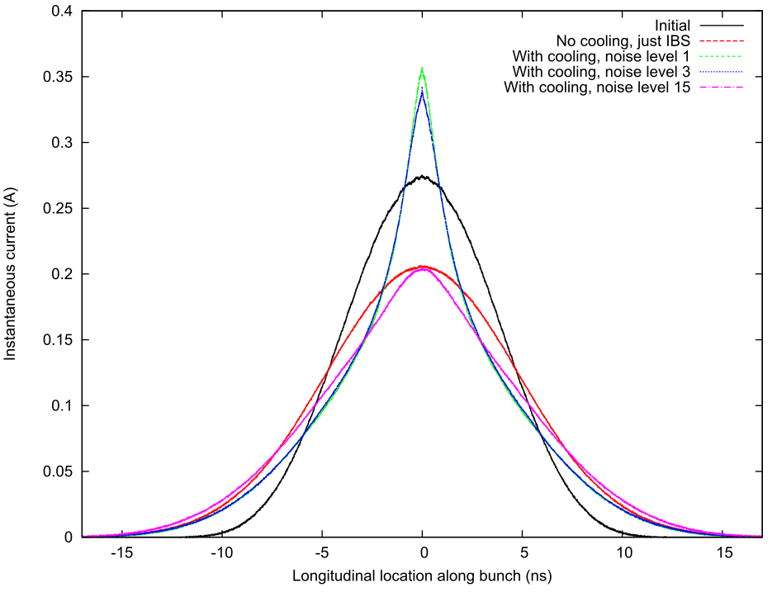
Tolerance of PCA-based CeC on the noise of electron beam
According to the simulation, the noise power in the electron beam should not exceed 200 times of the shot noise power.

Slide 29
Some Preliminary Estimates for eRHIC
In Beam frame
In lab frame

Slide 30
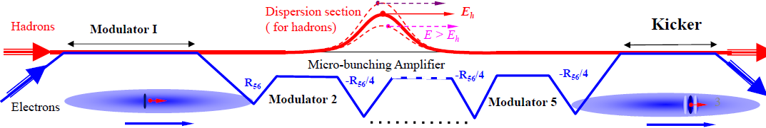
MBEC (Chicane-based CeC)
Enhanced bunching: single stage – VL, FEL2007
Micro-bunching: MB Amplifier, Single & Multi-stage, D. Ratner, PRL, 2013
Cooling rate for microbunched electron cooling without amplification, G. Stupakov, PRAB, 2018
Microbunched electron cooling with amplification cascade, G. Stupakov and P. Baxevanis, PRAB, 2019

Slide 31
Analysis of MBEC: Single Ion Approach I
© V.N. Litvinenko
Consider the following initial distribution of electrons (Spatially Beercan and Gaussian energy distribution)
After the modulation (kicked by a single ion) and the buncher, the distribution function is
The line density modulation at the exit of the buncher is thus

Slide 32
Analysis of MBEC: Single Ion Approach II
For the specific form of initial distribution, the integral can be reduced to
The electric field due to the density modulation can be calculated as follows (disc charge model)

Slide 33
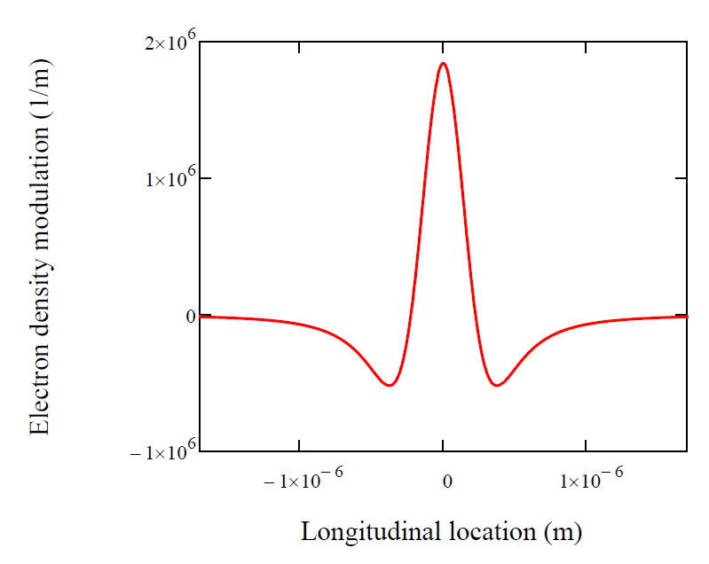
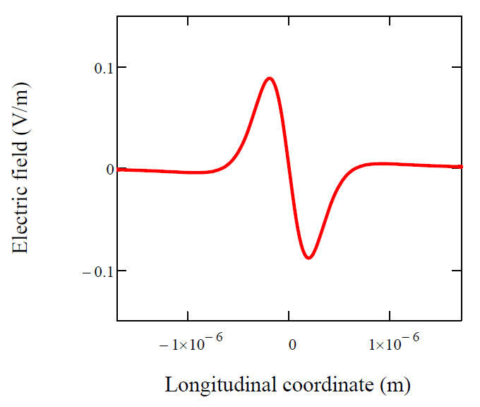
Analysis of MBEC: Single Ion Approach III
The following shows an example of our analysis:
Maximal reduction of energy error in one pass:
*This is the cooling time for energy spread and the cooling time for emittance should be a factor of 2 shorter.
Local cooling time:

Slide 34
Approach Used in PRL 111, 084802 (2013) by D. Ratner
© D. Ratner
‘Disc’ model

Slide 35
Analysis in Frequency Domain by G. Stupakov and P. Baxevanis
(PRAB 21 (2018), 114402)
© G. Stupakov
Single pass energy kick
Impedance due to MBEC
Cooling rate in 1/number of turns
Cooling rate is maximized at

Slide 36
Analysis in Frequency Domain by G. Stupakov and P. Baxevanis
(PRAB 22 (2019), 034401)
© G. Stupakov
With multiple amplification stages
With one amplification stage:
With two amplification stage:
Roughly speaking, every amplification stage increase the cooling rate by a factor of A.

Slide 37
Circulating Ion Beam Evolution in the Presence of CeC
CeC
Ion bunch
We take two approach to predict the evolution of the ion bunch in the presence of CeC:
Solving 1-D Fokker-Planck equation (analytical tool);
  Very fast (a few minutes on a pc)
  With limitations (currently work with linear cooling force, no beam losses from RF bucket, static diffusion coefficient…)
Macro-particle tracking (simulation tool).
  Time consuming (a few hours on a pc)
  More realistic and versatile

Slide 38
Analytical tools for predicting the influences of CeC to a circulating ion beam I
Evolution of the longitudinal phase space density of the ion bunch, after averaging over the synchrotron oscillation phase, follows the 1-D Fokker-Planck equation
In the limit of , an analytical solution can be derived for the following form of cooling profile and initial condition,
as
is called product logarithm function and can be directly evaluated in Mathematica.

Slide 39
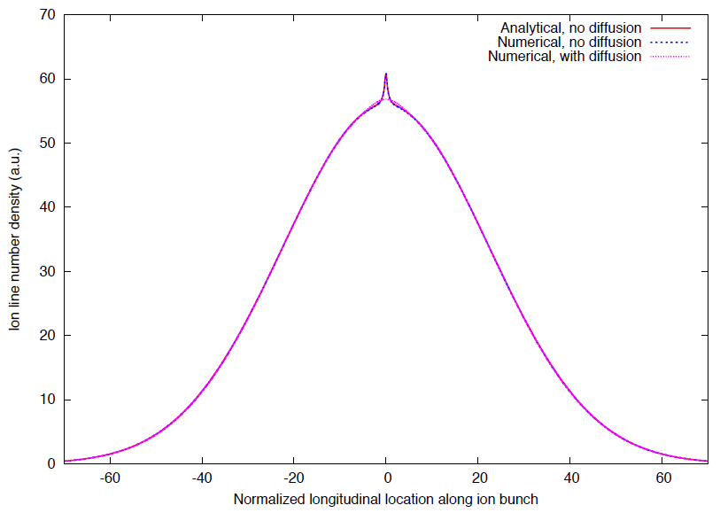
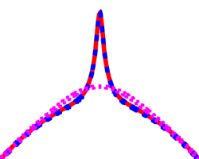
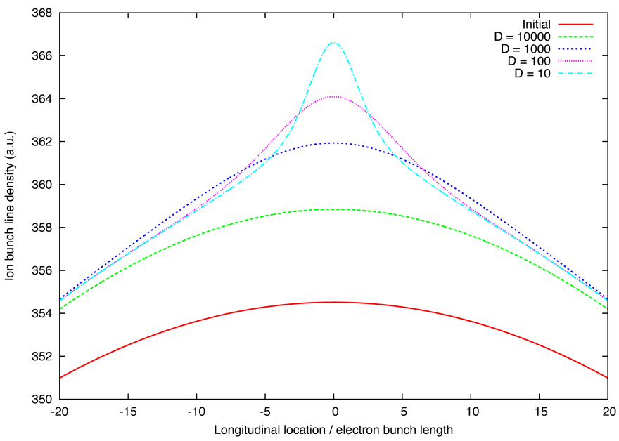
Analytical tools for predicting the influences of CeC to a circulating ion beam II
The longitudinal line density of ion bunch is given by
For , the 1-D Fokker-Planck equation can be solved numerically with arbitrary form of cooling rate and initial ion distribution.
The analytical studies reveals the fact that the central blips due to local cooling tends to be smeared out by diffusive kicks from IBS and more significantly, from incoherent kicks induced by neighbor ions.

Slide 40
Comparison with Macro-particle Tracking
Some limitations of the Fokker-Planck solver:
The Fokker-Planck solver assumes constant cooling rate (linear cooling force) inside electron bunch while macro-particle tracking assume sinusoidal cooling force;
The Fokker-Planck solver does not account for particle leakage from rf bucket or other rf-related effects.
The diffusion coefficients applied in Fokker-Planck equation does not change with time.

Slide 41
Future Work and Challenges
Since PCA-based CeC is planned to be tested in the next two years, it is our main focus to complete and improve the existing model:
  Develop PCA model for electron bunch with initial energy chirp;
  Develop PCA model for electron bunch with acceleration;
  Investigate how transverse-longitudinal coupling affects PCA;
  Exploring how cooling performance scales with various beam/accelerator parameters and searching for optimal settings;
  Develop 3-D model for PCA (Plasma oscillation with finite transverse size, transverse mode…).
Further improvement of MBEC may also include study the 3-D effects to cooling rate (plasma oscillation with finite transverse size) as well as how space charge (longitudinal and transverse) and emittance limit the gain.
For predicting the evolution of ion beam with cooling, further improvements include solving Fokker-Planck equation for non-linear cooling force and including transverse cooling into ion tracking code.
Further improvement of theoretical model for FEL-based CeC involves incorporating 3-D model for FEL at diffraction dominated regime, which has relative low priority at the moment.

Slide 42
Backup slides

Slide 43

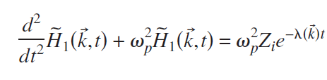



Debye shielding in an uniform electron plasma with anisotropic velocity distribution
The system can be described by linearized Vlasov-Maxwell equations
In 3-D Fourier domain, the equations reduces to a non-homogeneous 2nd ODE
The solution for zero initial density and velocity modulation in Fourier domain can be found
By inverse Fourier transformation, we obtain the density modulation in space domain

Slide 44
1-D integral for energy modulation

Slide 45
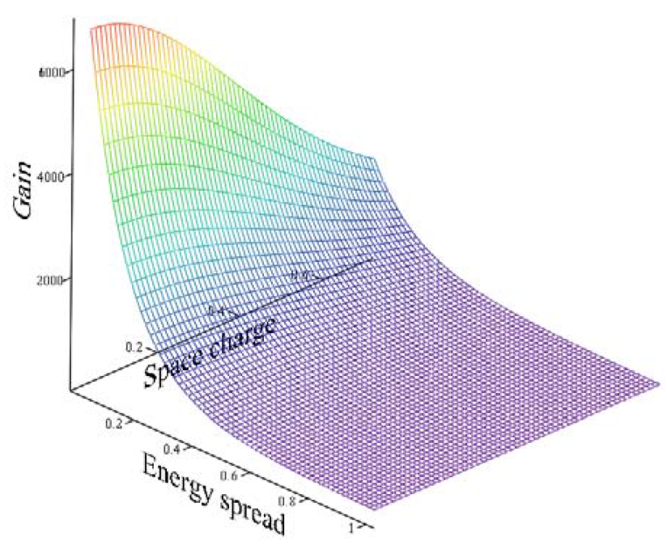
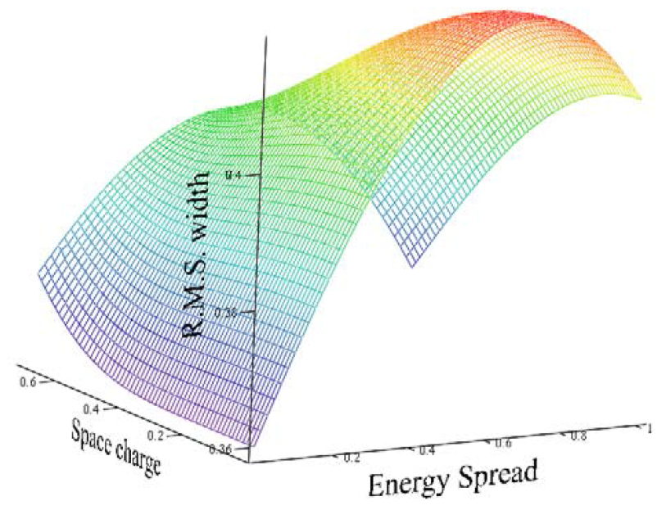
Analytical tools for FEL amplifier II
The 1-D FEL model with uniform beam provides us with some insights as well as scaling laws of how the wave-packets depends on various beam parameters
We also used the 1-D FEL model to study beam conditioning for CeC.

Slide 46
Start-to-end simulation for the single pass I
Steps for single pass start-to-end simulation:
At the entrance of the FEL, create macro-particles for the whole electron beam with proper shot noise. The 6-D distribution of the particles is determined by the beam dynamic simulation.
At the entrance of modulator, create one slice of macro-particles (with duration of one optical wavelength) with proper shot noise and 6-D distribution.
Run modulator simulation with the slice created in step 2. Due to periodic condition, the shot noise of the slice will stay correct.
Replace the corresponding slice created from step 1 with that output from step 3.
Run Genesis simulation. (Need to add macro-particles with negative energy to make it work as Genesis require each slice has the same number of macro-particles).
Take a proper portion of macro-particles output from GENESIS and import them into SPACE for kicker simulation.
Repeat step 1-6 but without the ion. The difference of step 6 and step 7 provides the single-pass coherent kick solely due to the ion.

Slide 47
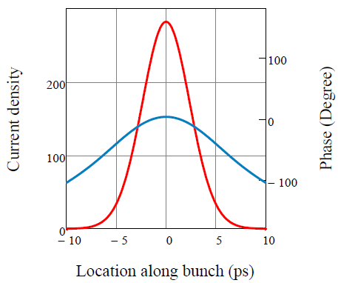
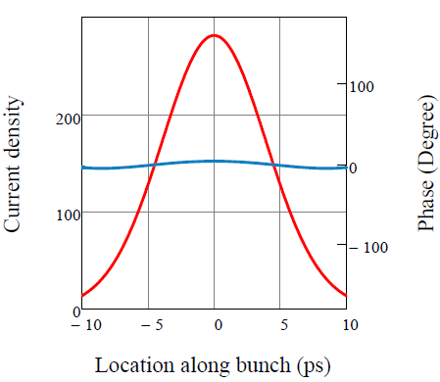
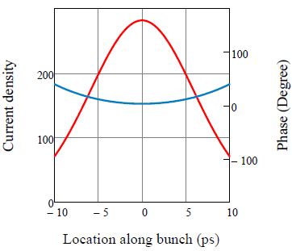
Analytical tools for FEL amplifier III
As the amplitude and phase of the wave-packets depends both on the local beam current and the local beam energy, it is possible to optimize beam parameters such that the cooling efficiency over the whole ion beam can be improved.
5 ps rms bunch length
8 ps rms bunch length
12 ps rms bunch length
With the same peak current density, there is an optimum bunch length to minimize phase variation of the wave packet with respect to ions located at different portion of the electron bunch.
Notes:
The top middle plot shows the results of the optimization. When the bunch length is 5ps, the effects from the density variation dominates. After increased to 8ps, the phase varation is reduced to ~5 degree. If increased further to 12ps, the phase variation is dominated by energy variation and over compensation take place. The three plots suggest that there is an optimal bunch length for minimizing the phase variation and for the specific parameters we used, the optimum bunch length is around 8ps.

Slide 48
Analytical tools for FEL amplifier IV
By requiring the relative density variation is smaller than one, we derived the upper limit of the FEL gain for the amplifier to work in the linear regime
γ=7460.52
Peak current: 30 A
Norm emittance 1 mm mrad
RMS energy spread 2.5e-5
λw=10 cm
a_{w} = 10
λo=90.73 nm
Mc = 70.6
(© Y. Jing, with code GENESIS)
3D Genesis simulation shows that the maximal gain in bunching factor is 18.7, which agrees with our estimation.

Slide 49
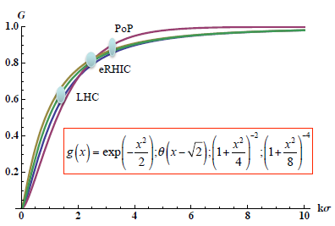
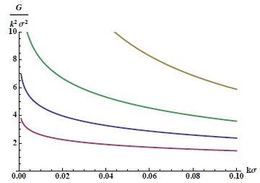
Field Reduction due to Finite Transverse Modulation Size
© V. N. Litvinenko

Slide 50
Analytical Prediction for FEL Amplifier I
The 1D FEL amplifier model with collinear radiation field and κ-1 (Lorentzian) energy distribution has been applied to study how the wave-packet forms inside the undulator.
Evolution of wave-packet along undulator as calculated from 1-D theory, showing that it take a few gain length for the wave-packet to overtake the initial modulation.
In high gain regime, the eigenvalues can be expanded into quadratic order in the detuning parameter , i.e.
which make it possible to obtain analytical form of the wave-packet

Slide 51
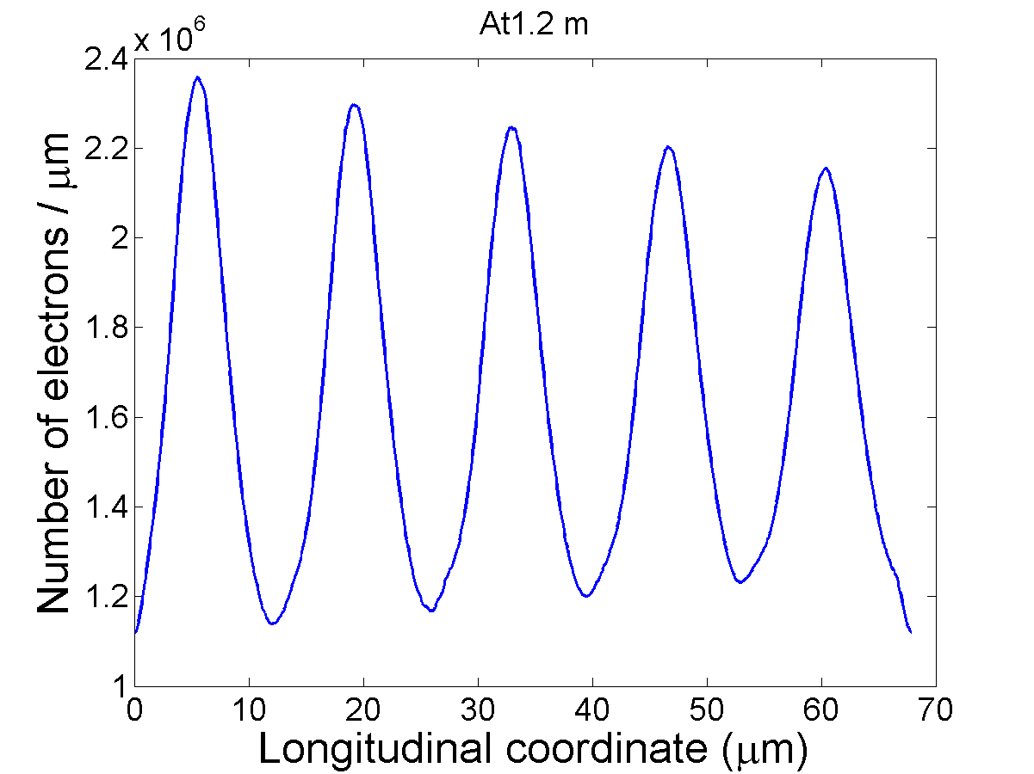
Background electron line density at the entrance of the kicker

Slide 52
Analytical Tools for Kicker I
Dynamic equation in Kicker is very similar to that in the modulator except the initial modulation in 6D phase space dominates the process. For κ-2 velocity distribution, the electron density perturbation is determined by:
with and
The solution of this inhomogeneous 2nd order differential equation reads

Slide 53
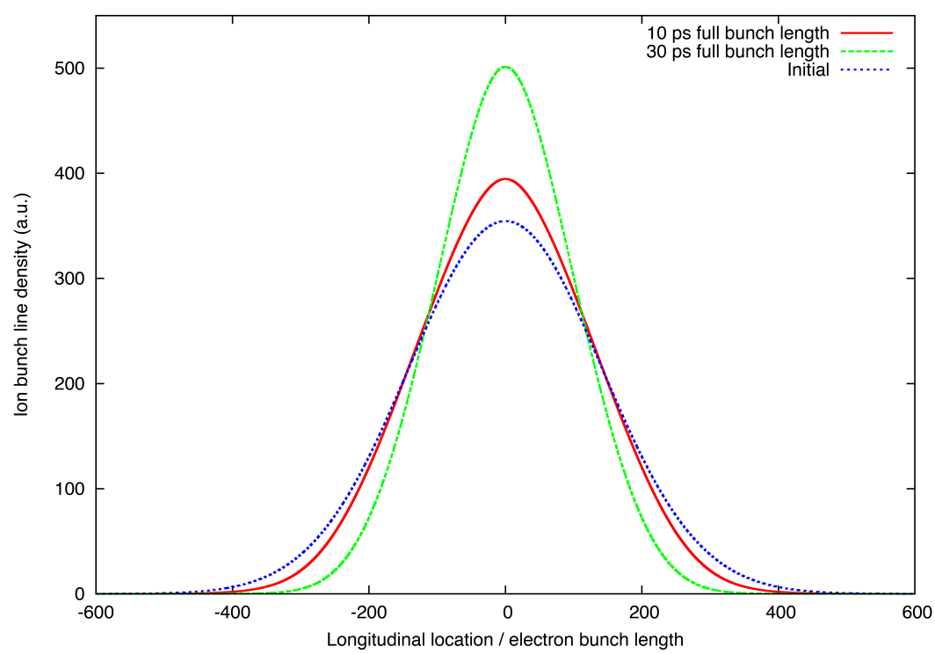
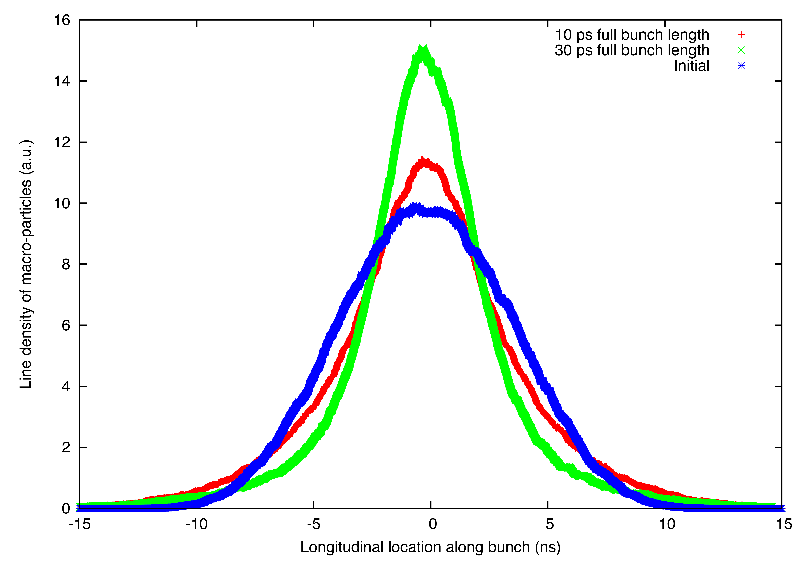
Simulation results for cooling 40 GeV Au beam
The plots show how the longitudinal profile of ion bunch evolves after 40 minutes of cooling with 10 ps (red) and 30 ps (green) electron bunch. The left plot is generated by solving Fokker-Planck equation as described in the previous slides and the right plot is created by the macro-particle tracking code. The parameters applied are for cooling 40 GeV RHIC gold ion beam.
Macro-particle tracking
Fokker-Planck solver

Slide 54
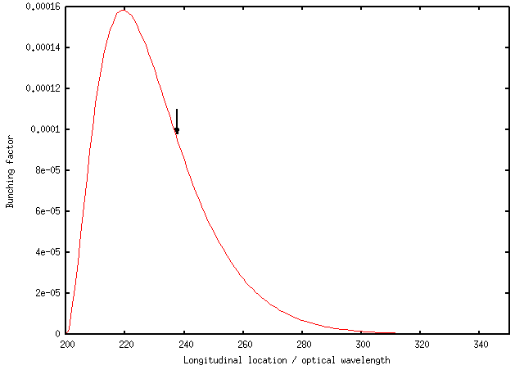
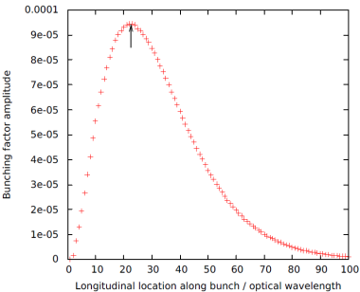
Reduce a_{w} to align ion with wave-packet
Current: 35A,
a_{w}: 0.5
Gamma: 28.66,
Norm. emittance: 5e-6 m
ion
ion
Current: 62 A,
a_{w}: 0.37

Slide 55
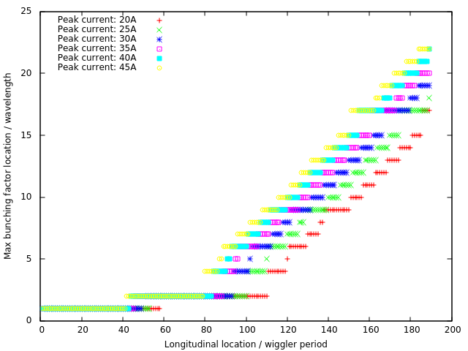
How wave-packet peak location depends on peak current II

Slide 56
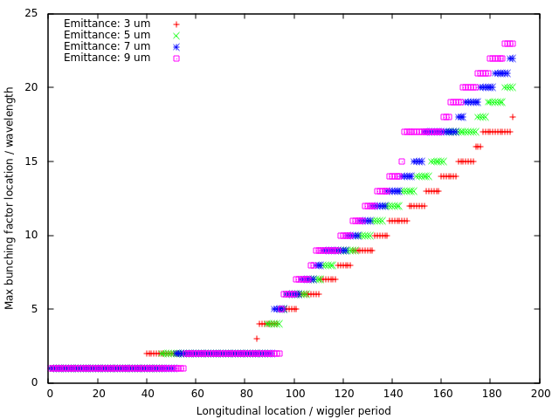
How wave-packet peak location depends on emittance

Slide 57
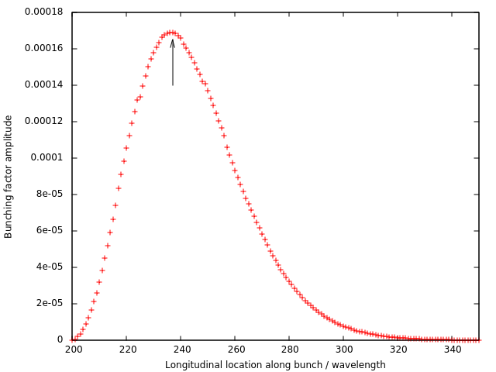
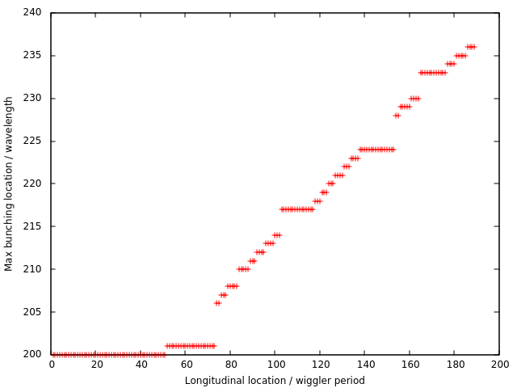
Combining the above two effects:
22 um emittance and 85 A current
The ion does arrive at slice #237

Slide 58
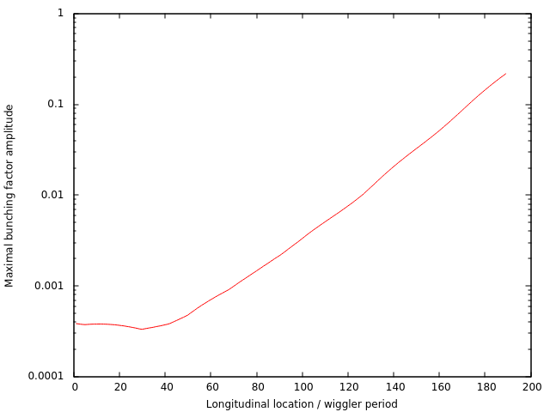
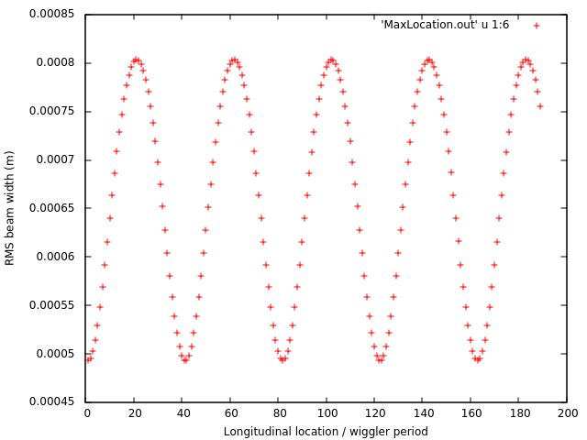
The FEL looks not saturated
Amplification of shot noise
Transverse beam size

Slide 59
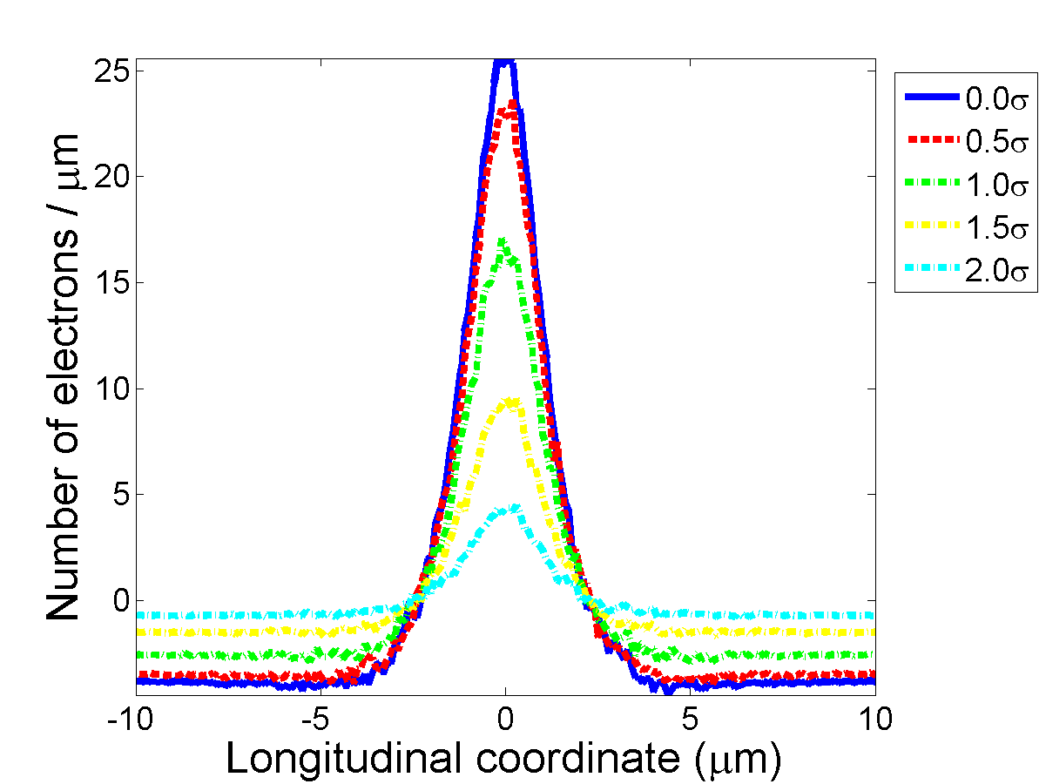
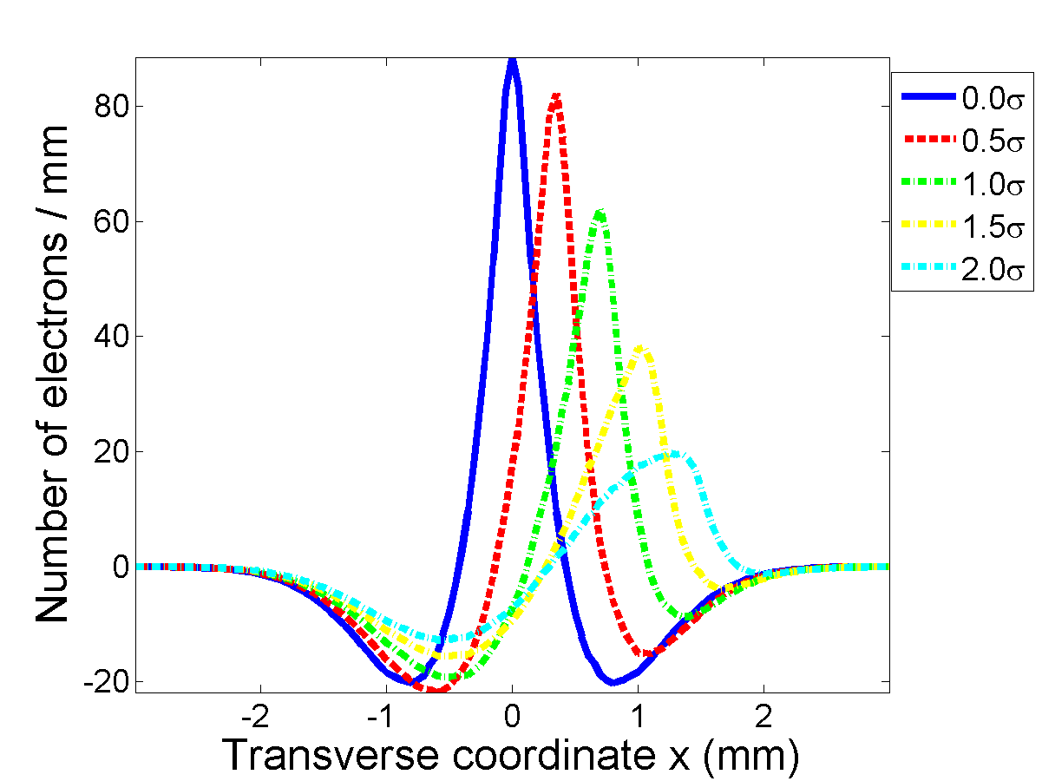
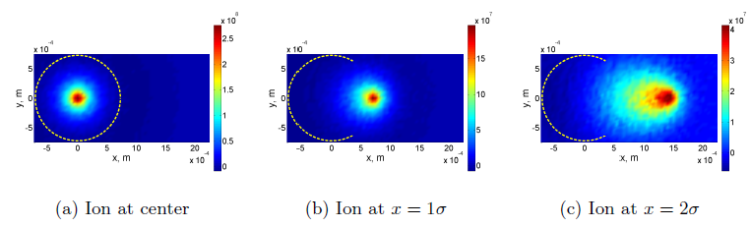
Simulation Tools for the Modulation Process II
(© J. Ma, with code SPACE)
  Simulation results for a continuous focusing channel (Beam is matched and transverse beam size does not vary.)
Modulation is less effective for an off-centered ion. For an ion sitting at 1σ away from transverse electron beam center, the longitudinal density modulation reduces by ~40%.
The transverse density modulation profile induced by an off-centered ion is significantly different from that induced by an ion at beam center

Slide 60
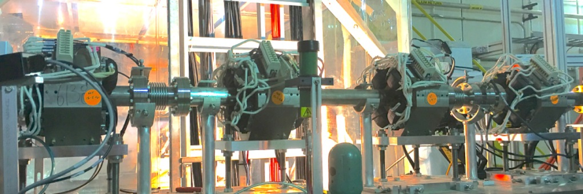
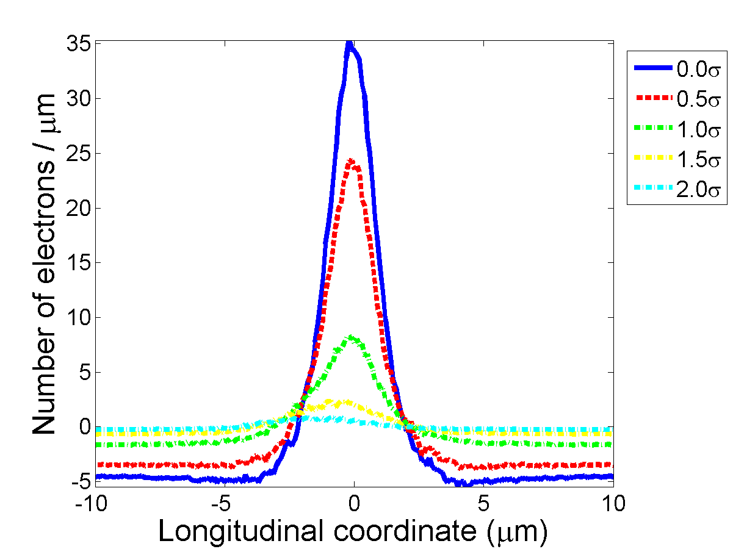
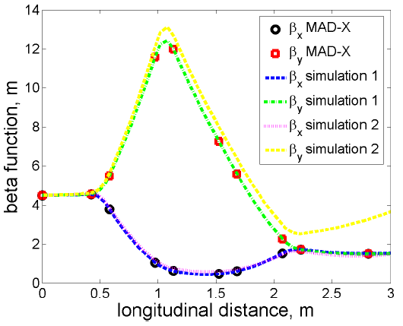
Simulation Tools for the Modulation Process III
(© J. Ma, with code SPACE)
Simulation results for a quadrupole focusing channel (Transverse beam size varies along the modulator)
  Beta function extracted from SPACE agrees with that from MAD-X calculation when space charge is turned off in SPACE simulation.
  When space charge is turned on, the vertical lattice function at the end of modulator deviates significantly from that calculated by MAD-X.
  The efficiency of longitudinal density modulation depends strongly on the quadrupole settings, which has to be taken into account in optimizing the system.
Beta function along modulator (not optimized)
Longitudinal density modulation

Slide 61
Genesis Simulation with Undulator Consisting of 3 Subsections
G. Wang and J. Ma
It seems possible to configure Genesis so that it simulates a multi-section undulator without input/output particles&radiations. We use awd and magnets.in file to do the simulation.

Slide 62
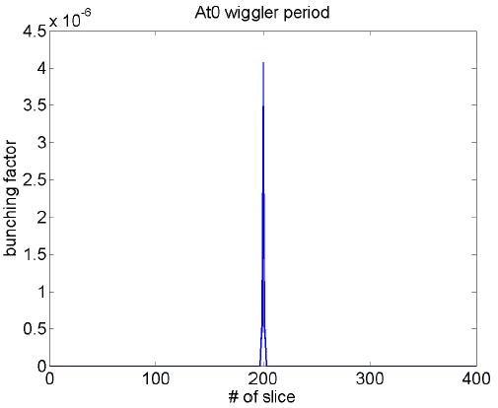


Simulation tools for FEL amplifier
We use GENESIS 1.3 to simulate the amplification process in the FEL amplifier.
Following the approach of perturbative trajectories, we run two sets of FEL simulation: one with shot noise plus modulation induced by the ion and the other one with shot noise only. The wave-packet due to the ion is extracted from the difference of the two sets of simulation. The plots are results for 20 MeV electrons.

Slide 63





Simplified Genesis Simulation for 14.6 MeV Electron Beam
Bunching factor at ion’s location
Power gain length, 40A
We assume one long undulator and mismatch is intentionally introduced to reflect the beam size variation for a three subsection undulator.
The power gain length is about 10% longer than that derived from Ming Xie’s formula.
With a peak current of 35A~40A, we should get a gain of 100~200 for the bunching factor.
Below 40A, the FEL works in the linear regime.
With shot noise to check saturation

Slide 64





Simulation tools for kicker
(© J. Ma, with code SPACE)
The macro-particles from GENESIS simulation are imported into SPACE for the kicker simulation.
Background line density is 2e6/μm.
The evolution of the wave-packet shows similar behavior as that obtained from analytical model, i.e. the wave-packet amplitude increases initially and then starts to decrease.

Slide 65




Start-to-end simulation for the single pass
(© J. Ma, with code SPACE and GENESIS)
One example of start-to-end simulation (to cool 40 GeV Au)
Modulator
Amplifier
Kicker

Slide 66
Simulation tools for predicting the influences of CeC to a circulating ion beam II
Assuming the ion density does not vary significantly over the width of the wave-packet
The one-turn energy kick due to CeC is
Diffusive kick induced by neighbor electrons, i.e. electrons’ shot noise

Slide 67
Simulation tools for predicting the influences of CeC to a circulating ion beam I
Energy kicks from CeC is
Coherent kick induced by the ion itself
Incoherent kick induced by the neighbor ions (using the Gaussian profile as obtained by quadratic expansion of FEL eigenvalues)
Since there is no correlation between any successive incoherent kicks, one can use a random kick to represent the incoherent kicks
For a random number uniformly distributed between -1 and 1

