Slide 1
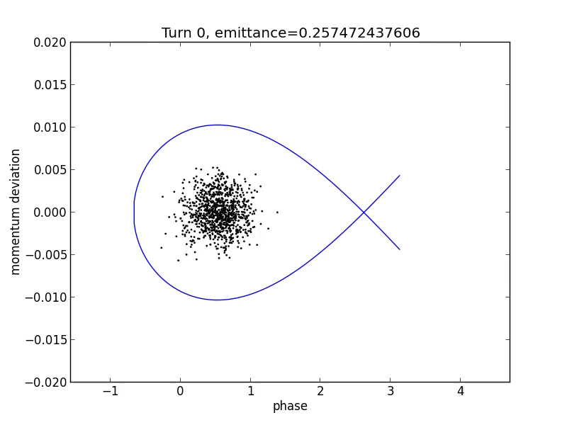
Phase Space Area
Examples and Evolution I
A Matched case
(Perfect injection):
Initial conditions match:

Slide 2
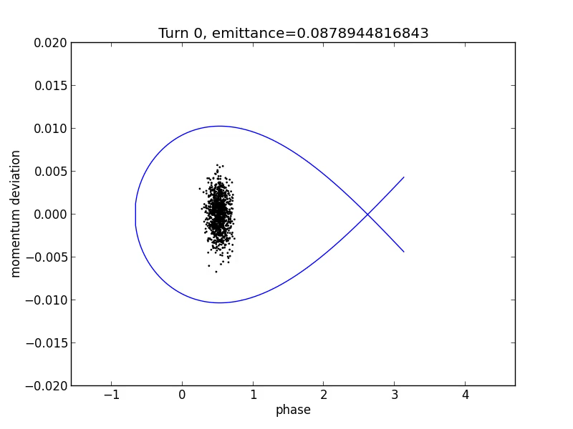
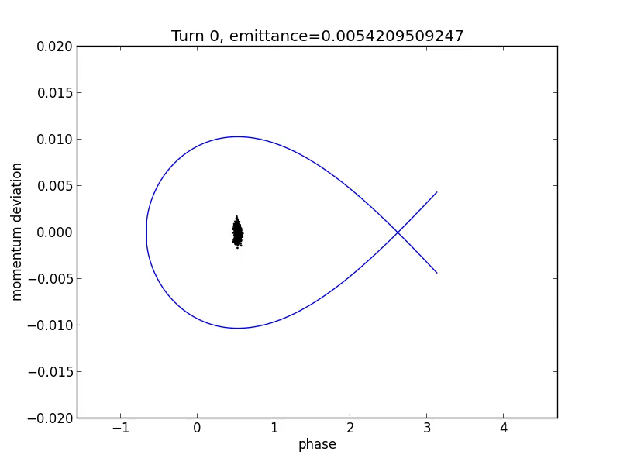
Phase Space Area
Examples and Evolution II
An unmatched case
Notes:
\frac{\left<\delta\right>}{\left<\Delta\phi\right>}=\frac{3Q_s}{h\left|\eta\right|}

Slide 3
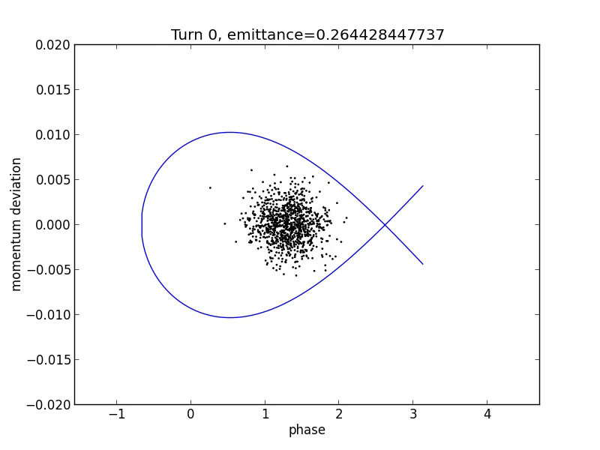
Phase Space Area
Examples and Evolution III
Time jitter at injection, other wise same as the matched case:
The phase error is:

Slide 4
Credits
Credit to Prof. Yue Hao are for the animations

