Slide 1
EIC SHC design progress
Jun. 11th 2021
Erdong Wang on behalf of EIC SHC team

Slide 2
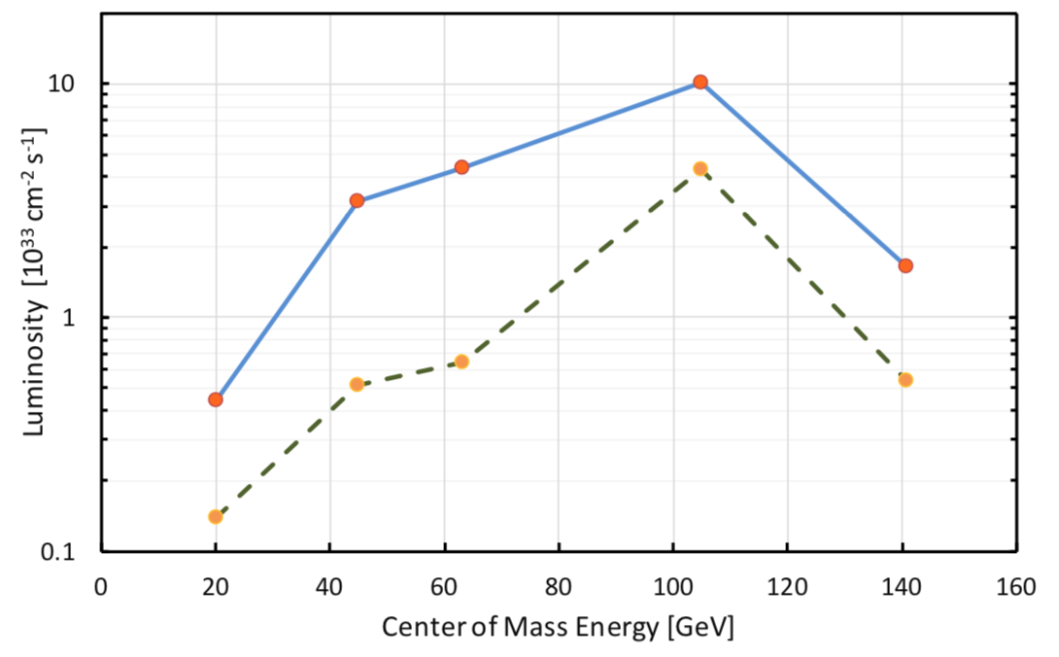
EIC cooling requirements
Cool the proton beam at 275 GeV, 100 GeV and 41 GeV.
IBS longitudinal and transverse(h) growth time 2-3 hours. Cooling time shorter than IBS growth time
Cool the hadron beam normalized rms vertical emittance from 2.5 um(from injector) to 0.5 um in 2 hours.
Amplification gain ~400, utilizing the realistic IR 2 space for modulation/kicker/amplification.
with SHC
w/o SHC
Notes:
In evaluation of average luminosity, we should cool the vertical in first 2 hours in the store. We plan to maintain the collisions in the same time, by slowly adjusting down electron vertical beta-function in the IP as the proton vertical emittance decreases. After 2 hours the proton beam emittances should be at their design table values, then the cooler is retuned to maintaining these emittances against IBS.

Slide 3
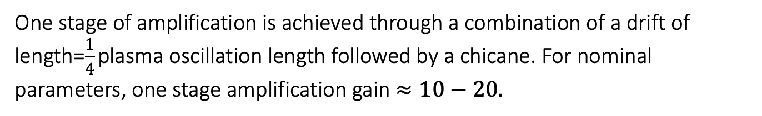
MBEC cooling is selected for EIC
Micro-bunched electron cooling (MBEC) was proposed by D. Ratner (PRL, 111, 084802 (2013)). It has an advantage of broad-band amplification (in contrast to the FEL).
One stage of amplification is achieved through a combination of a drift of length=$\frac{1}{4}$ plasma oscillation length followed by a chicane. For nominal parameters, one stage amplification gain $≈10−20.$
From G. Stupakov

Slide 4
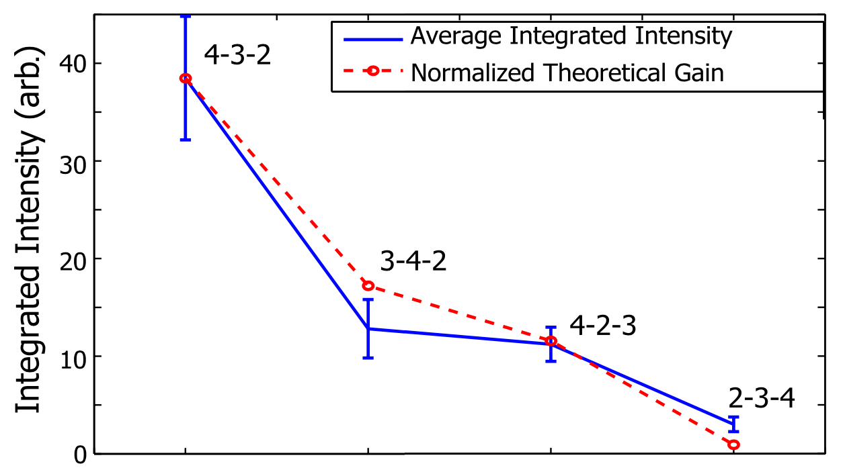
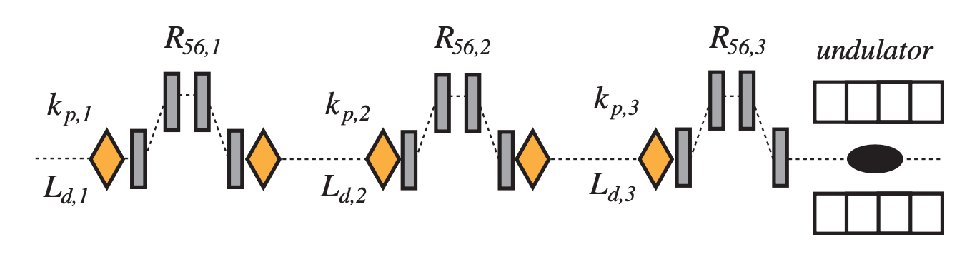
MB amplification tested experimentally
Micro-bunched amplification is well known in FELs (Saldin et al., NIMA 528, 355 (2004); Dohlus et al. PRAB 14, 090702 (2011)). It has been tested experimentally at NLCTA facility at SLAC (Marinelli et al. PRL 110, 264802 (2013)).
Beam line for the NLCTA experiment
Signal intensity increases when the chicane strength is optimized. Good agreement with theory.
From G. Stupakov

Slide 5
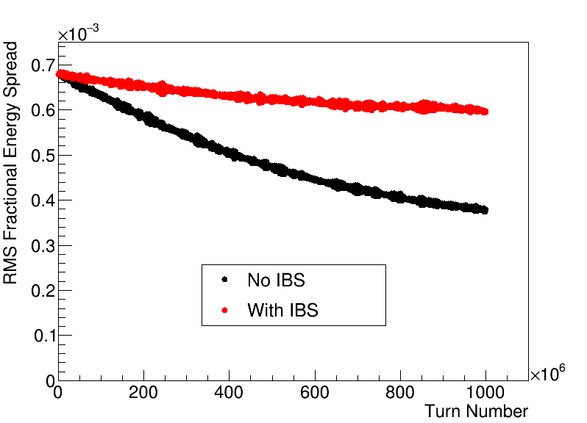
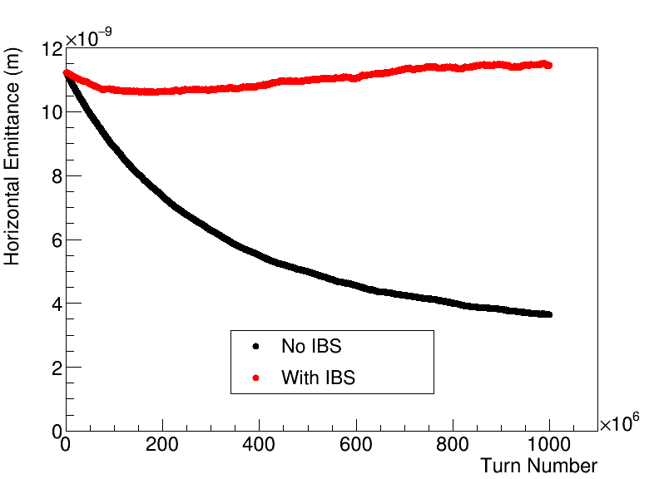
Cooling analysis tools I: turn by turn simulation
@W. Bergan
Simulate interplay between cooling, diffusion, and IBS in two planes (longitudinal and horizontal)

Slide 6
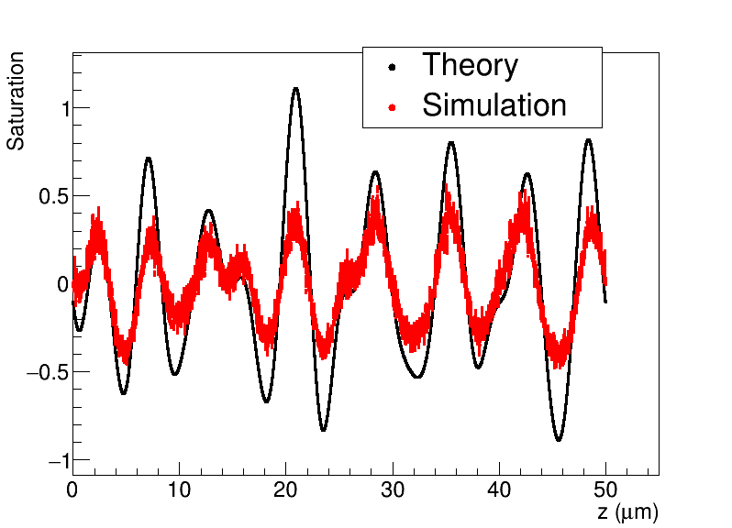
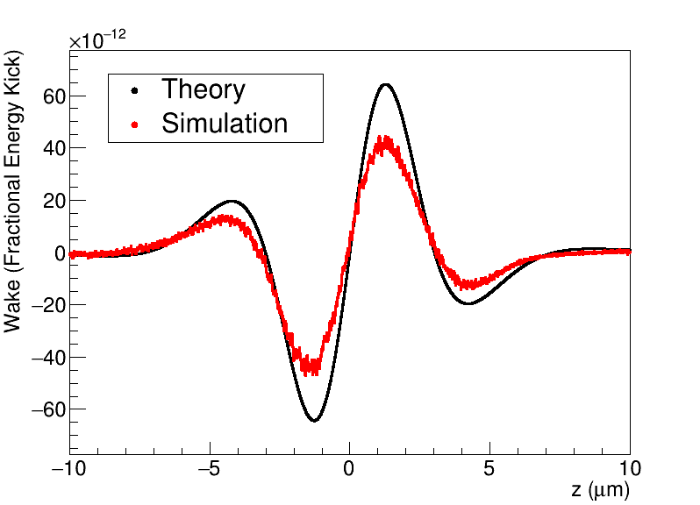
Cooling analysis tools II: 1D plasma simulation
Obtain saturation information and determine impact on the wake

Slide 7
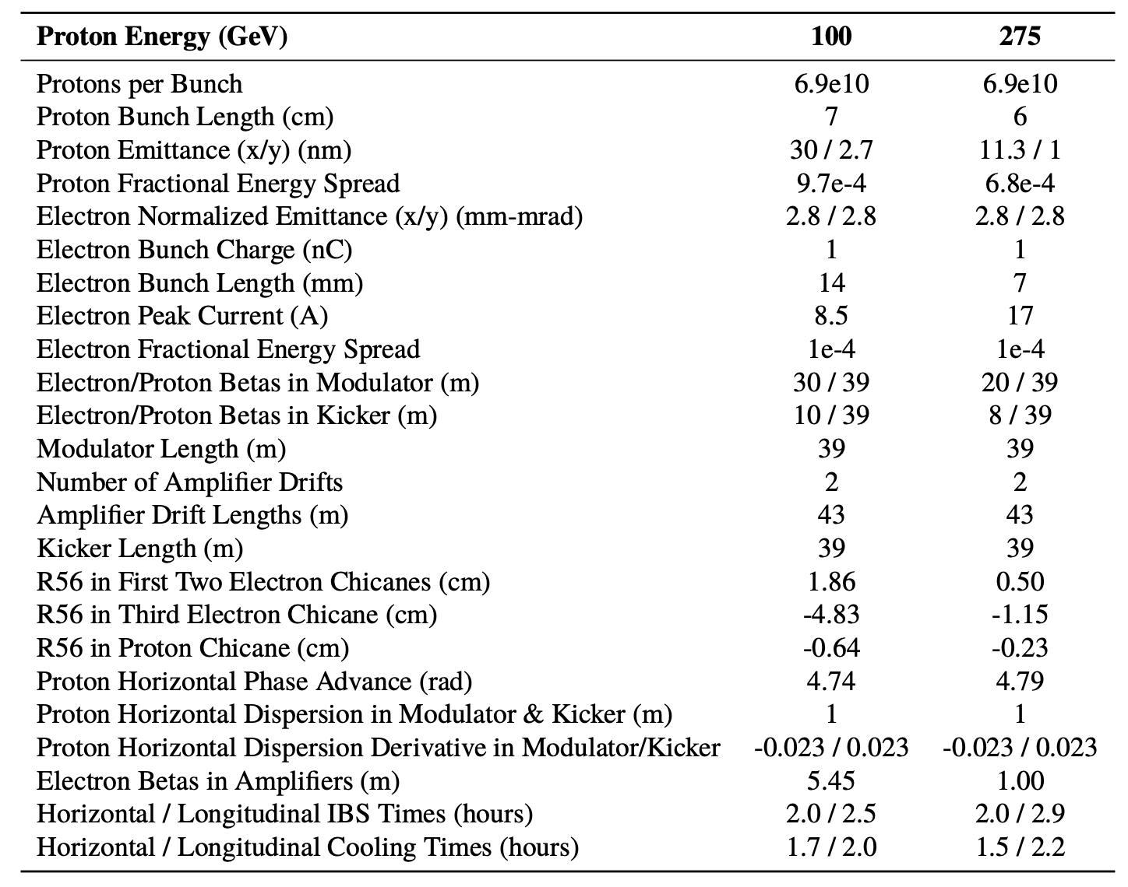
EIC SHC parameters
@ W. Burgan
The 275 GeV and 100 GeV cases have been optimized.
41 GeV case will be studied later.

Slide 8
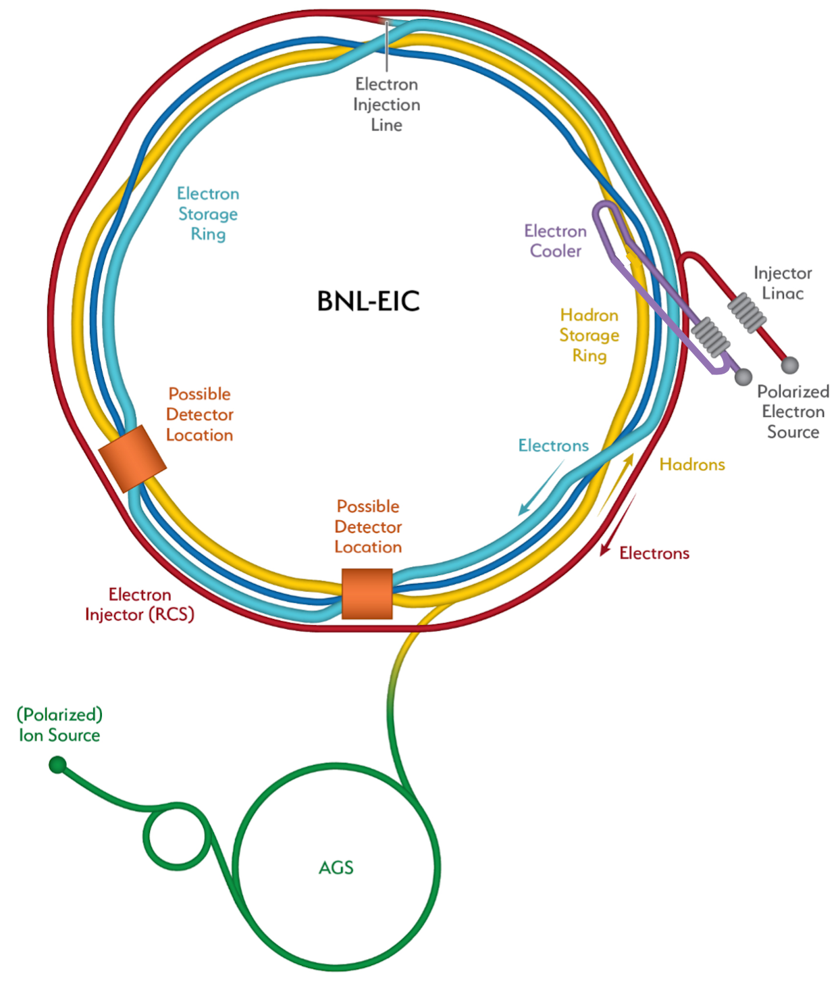
e-cooler facility layout
Share the same Linac tunnel and electron source building of EIC pre-injector
Hadron chicane for pathlength and R56 adjustment using displaced s.c. dipole magnets at IR2 straight section.

Slide 9
EIC Strong Hadron Cooling Facility
400kV DC gun for 100 mA of beam and 4 MV SRF injector
Dogleg ERL merger
149 MeV Super conducting Energy Recovery LINAC ( in existing tunnel)
e Beam transport to merge hadron beam
Amplification section with chicanes for electrons
Hadron chicane (existing magnets) path length matching & R₅₆ adjust
Return transport of electron beam to ERL
2 K He sub cooler station, RF and power infrastructure
Electron beam instrumentation and diagnostics

Slide 10
Accelerator design constrains and strategies
All the selected technologies are less than factor of 2 beyond the state-of-the art.
Meet cooling parameters and get the best beam quality are always the 1st priority.
Reasonable cost

Slide 11

Base selections of ERL
 |  |  | Reasons
ERL | Multi turns | Single turn | No large bending before cooling: eliminate CSR, large R56
Electron source | HVDC gun | SRF gun | HVDC gun achieved 65 mA / 2 nC
LINAC fundamental frequency | 591 MHz | 197 MHz | 591MHz is matured.>18 MV, reasonable cost

Slide 12
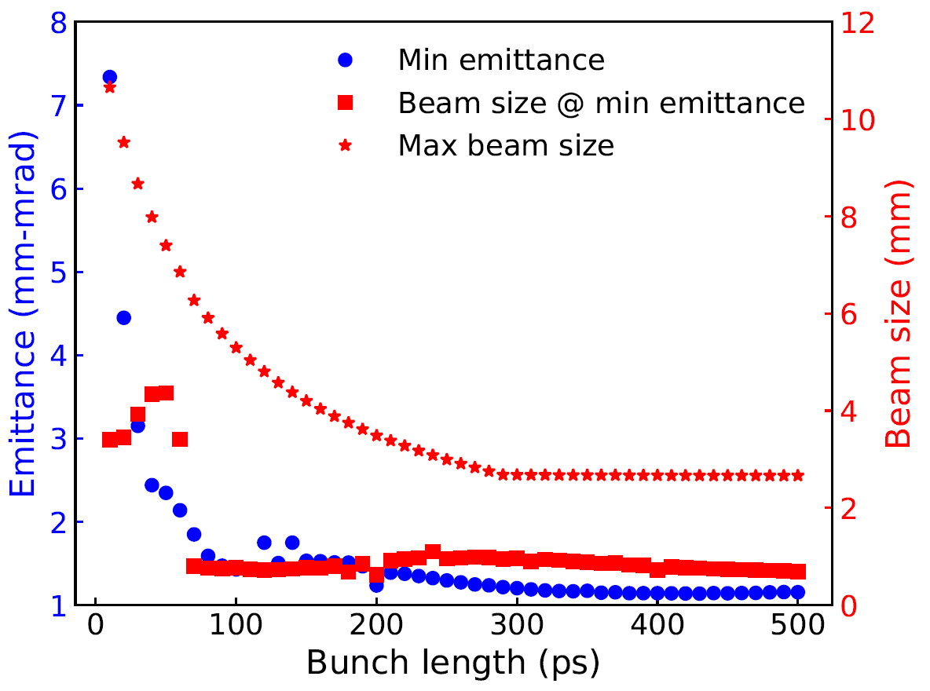
HVDC gun
Initial bunch length
HVDC gun is the only electron source achieved 65 mA; 2nC (separately)
SRF gun < 2 mA; recently operational SRF gun < 1 mA avg.(waiting R&D results)

Slide 13
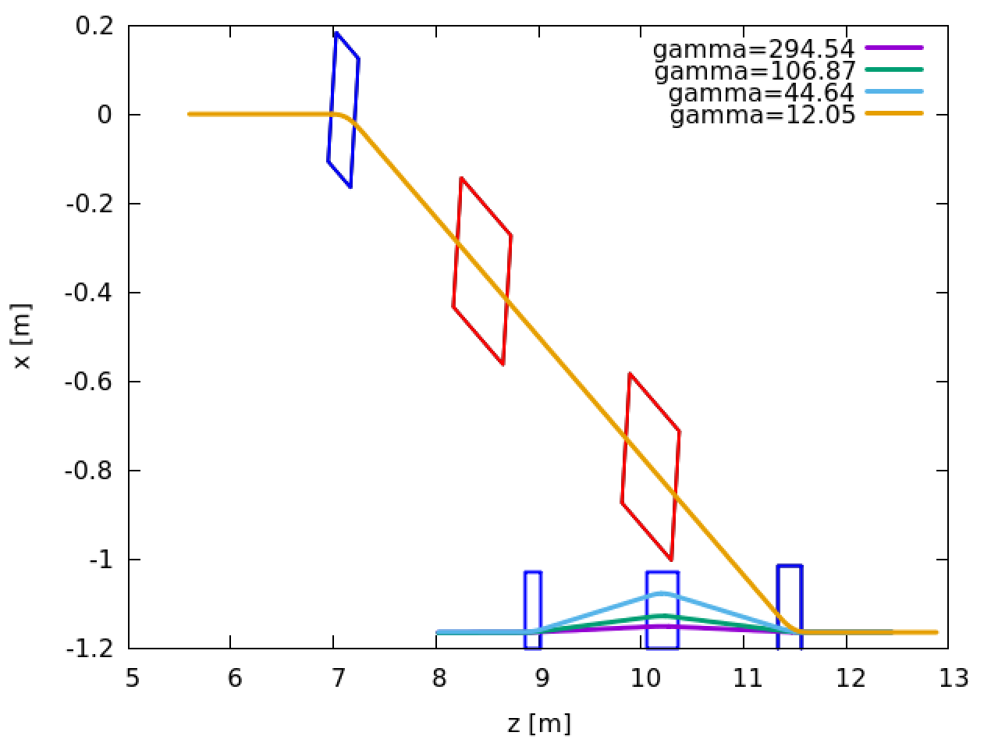
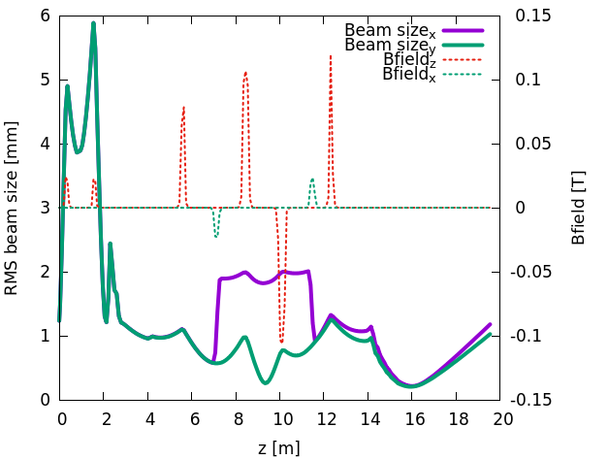
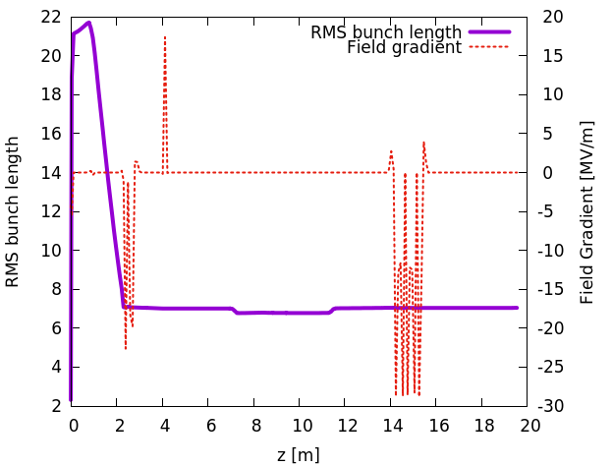
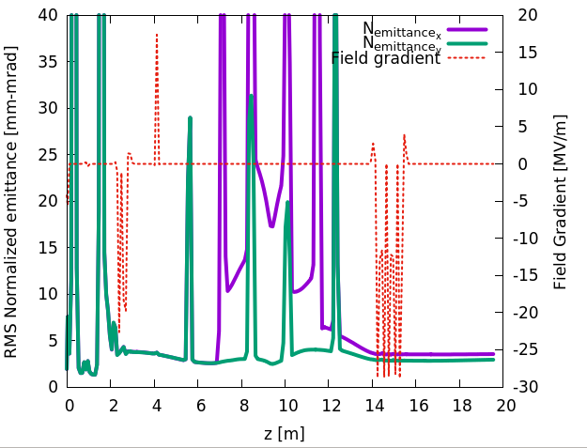
ERL injector
Injector energy 5.6 MeV
Dual solenoids dogleg merger( three energies)
HVDC
197 MHz buncher
591 MHz SRF
1773 MHz
7 mm
ex=2.8 u
ey=3.5 u

Slide 14
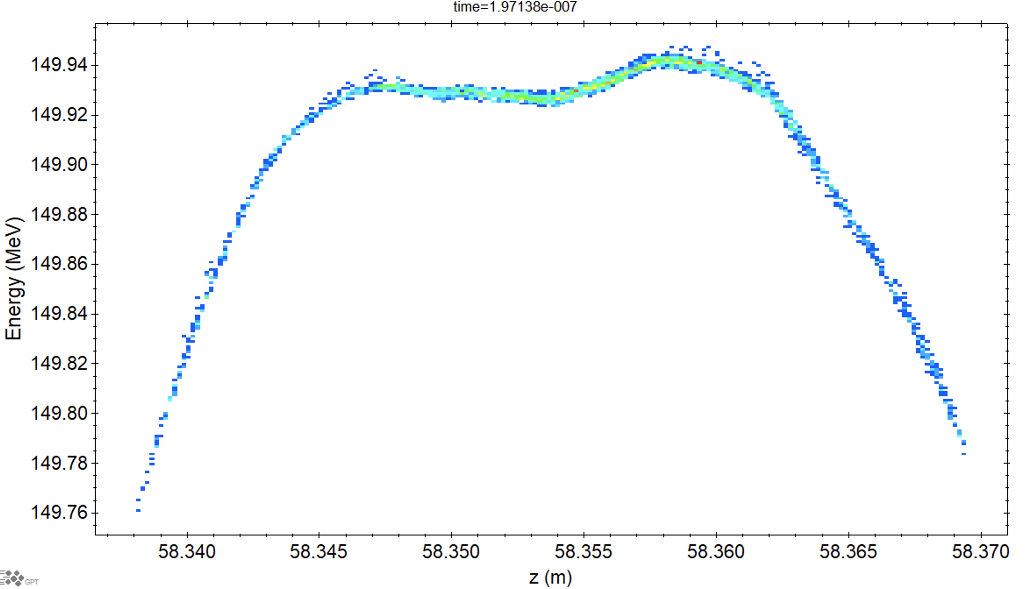
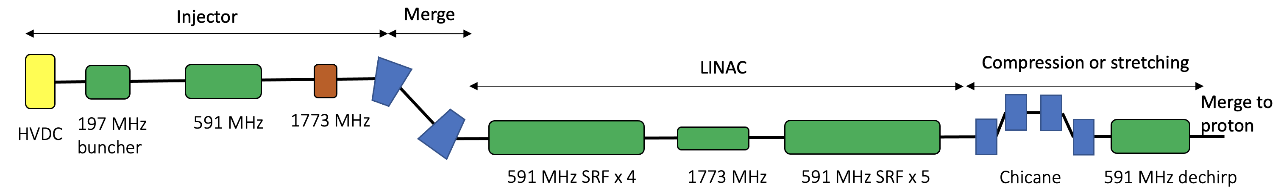
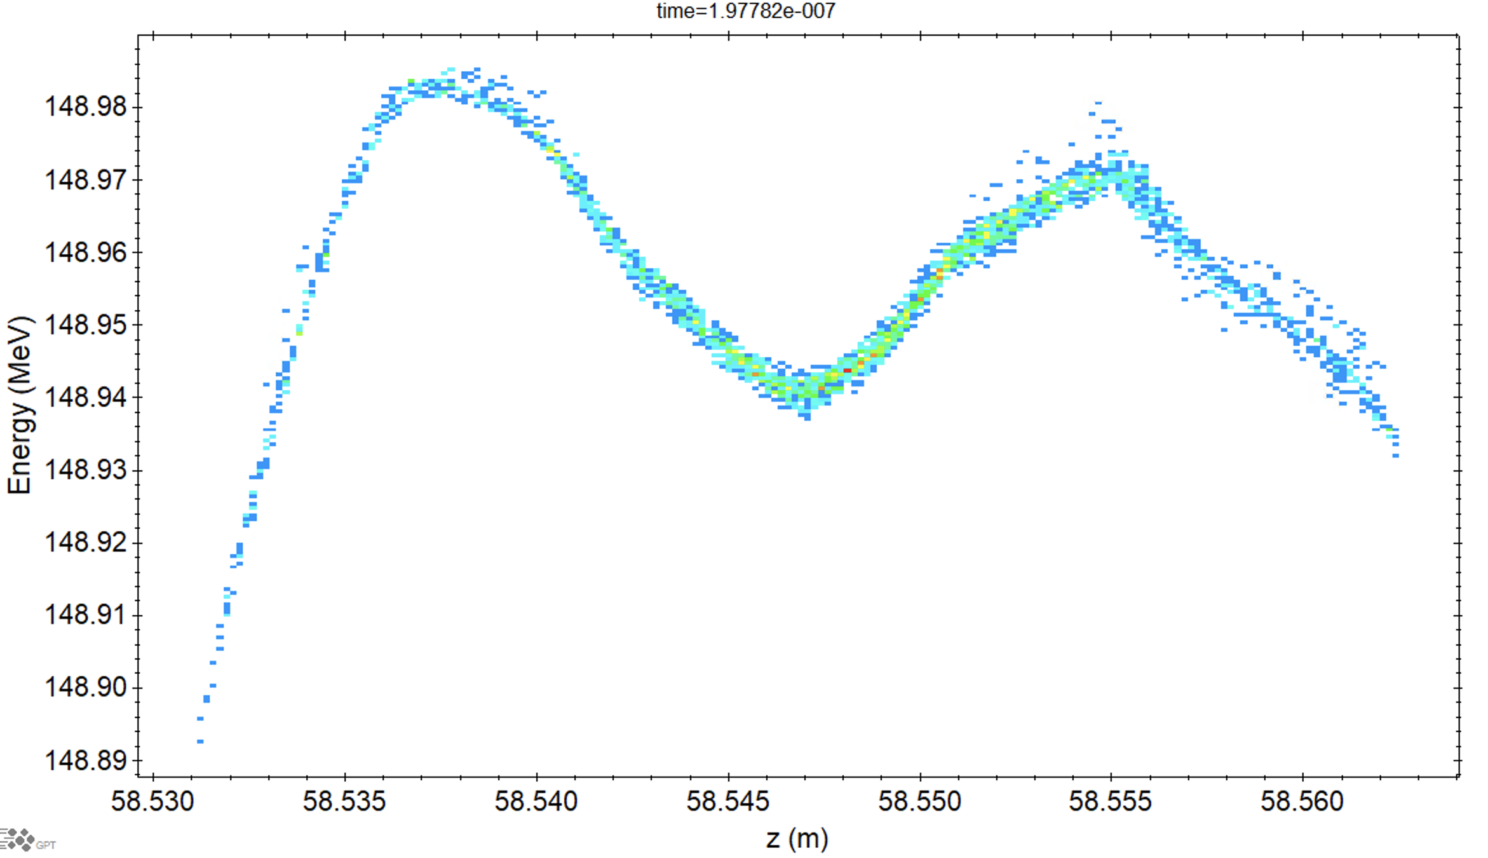
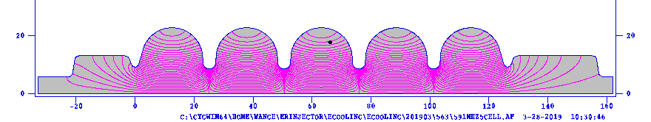
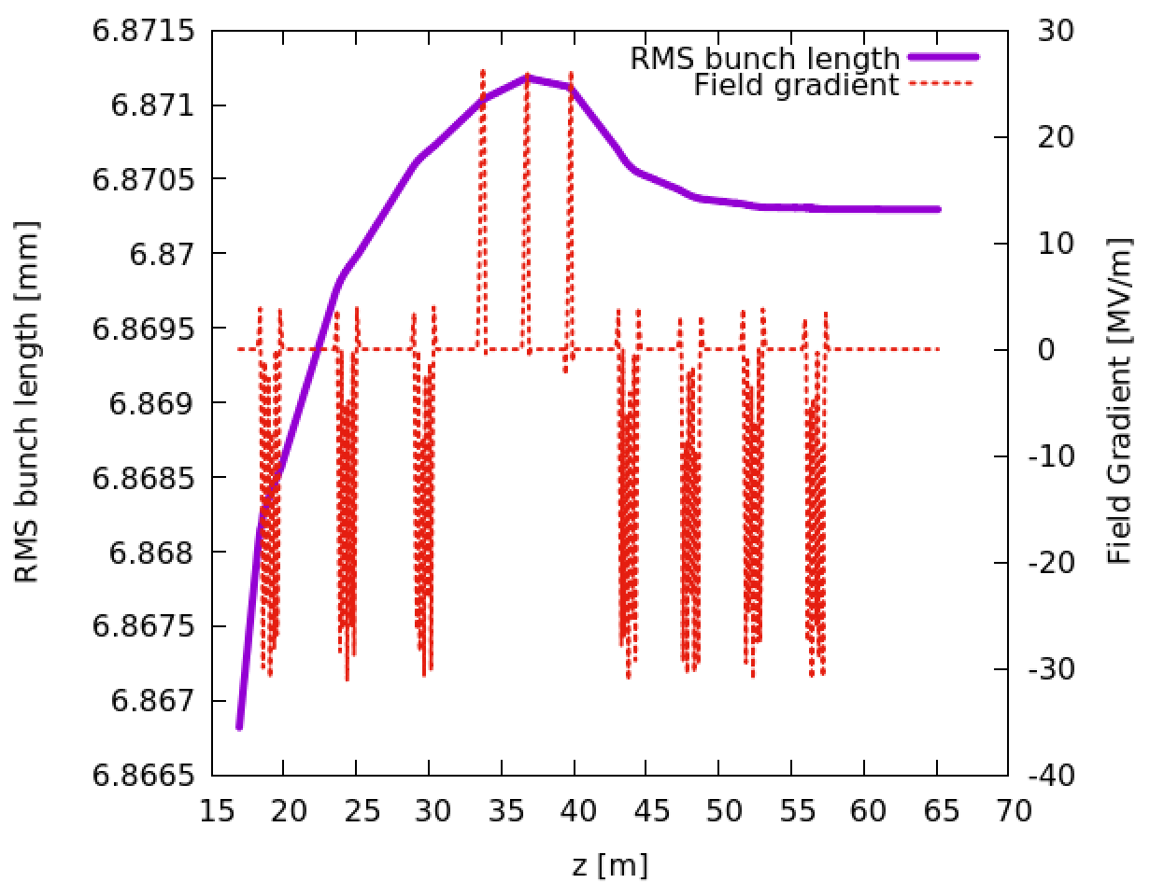
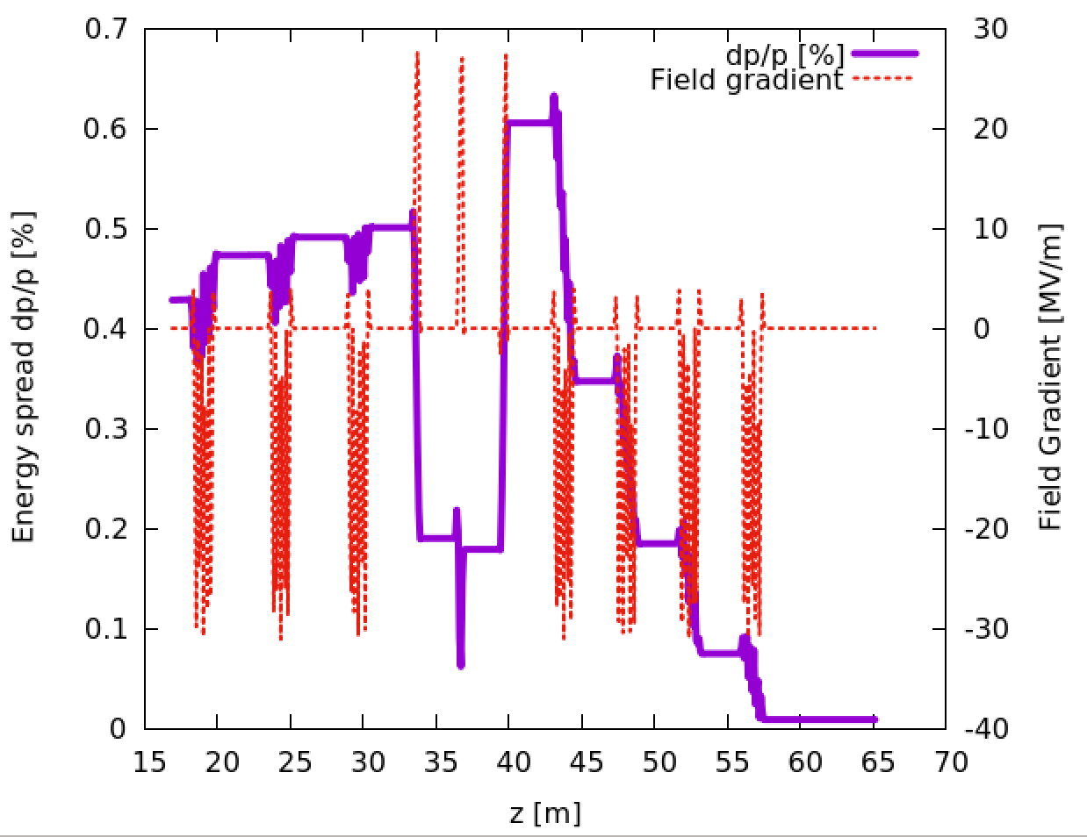
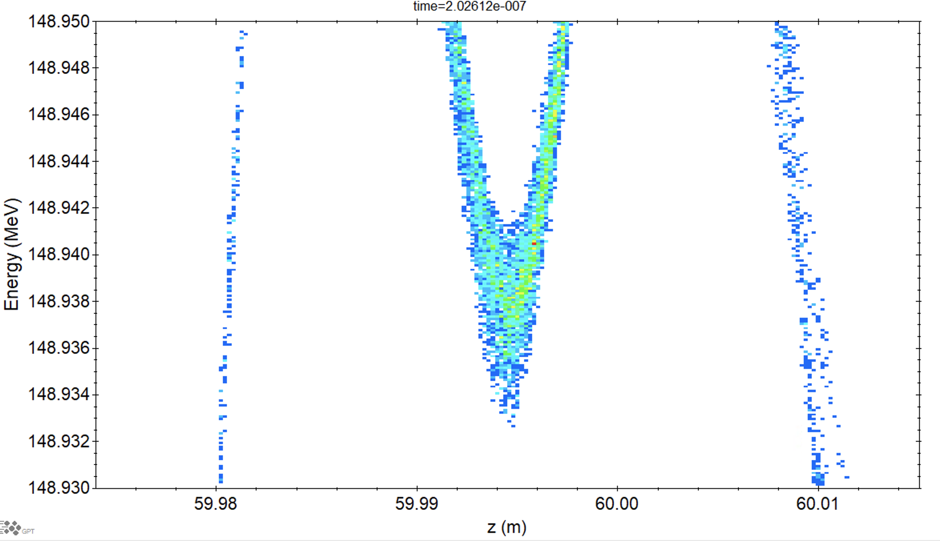
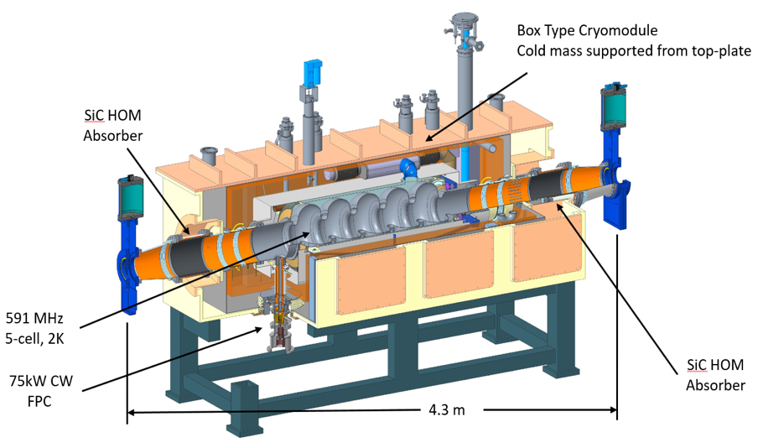
Gun to hadron merger design
Option 2
3D simulation code GPT, including CSR
Option 1
Rms dp/p=8.6e-5
Sliced dp/p=4e-5

Slide 15
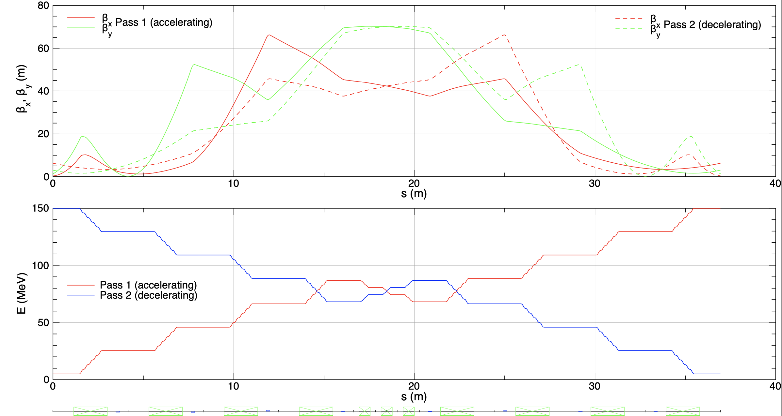
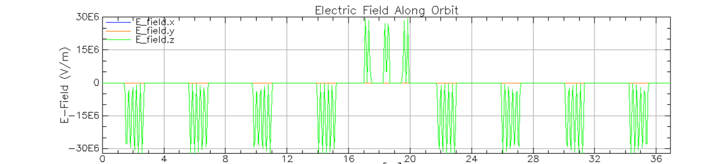
Beam profile for 2 pass
6/11/21
15

Slide 16
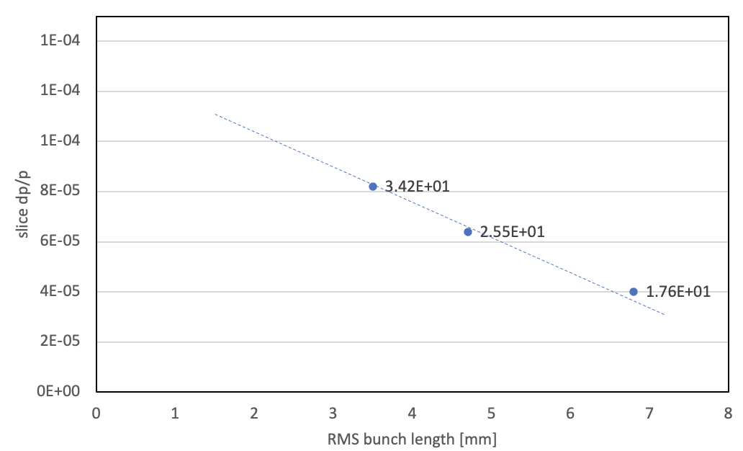
e-beam parameters before cooling
 | parameter
Bunch charge | 1 nC
Peak current | 17-34 A
RMS Bunch length | 6.8-3.4 mm
RMS Normalized emittance | 3 mm-mrad
Energy | 150 MeV
RMS dp/p | <8.6 e-5
Peak current [A]
Injector and Linac are simulated by advanced 3D space charge code GPT 3.4(including CSR).

Slide 17
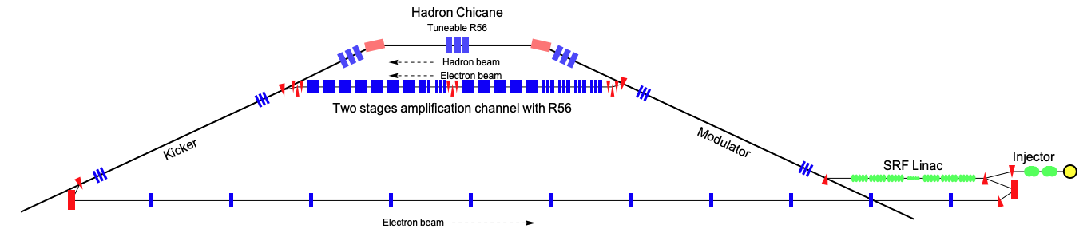

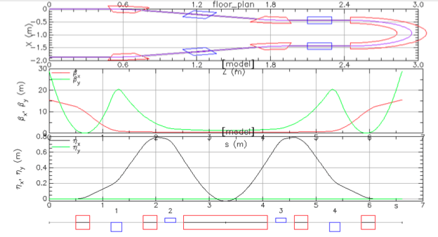
R56 canceled bending
To eliminate unwanted micro-bunching
Bates bending for 180 return
R56, dispersion Tunable
16 deg bending:
Place a Chicane at center cancel out R₅₆
Two quads triplets: achromatic bend
180 deg bending:
Bates bending to cancel out R₅₆

Slide 18
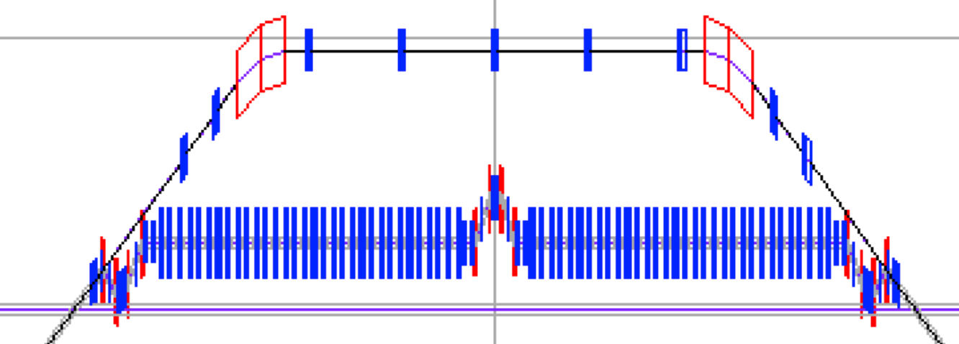
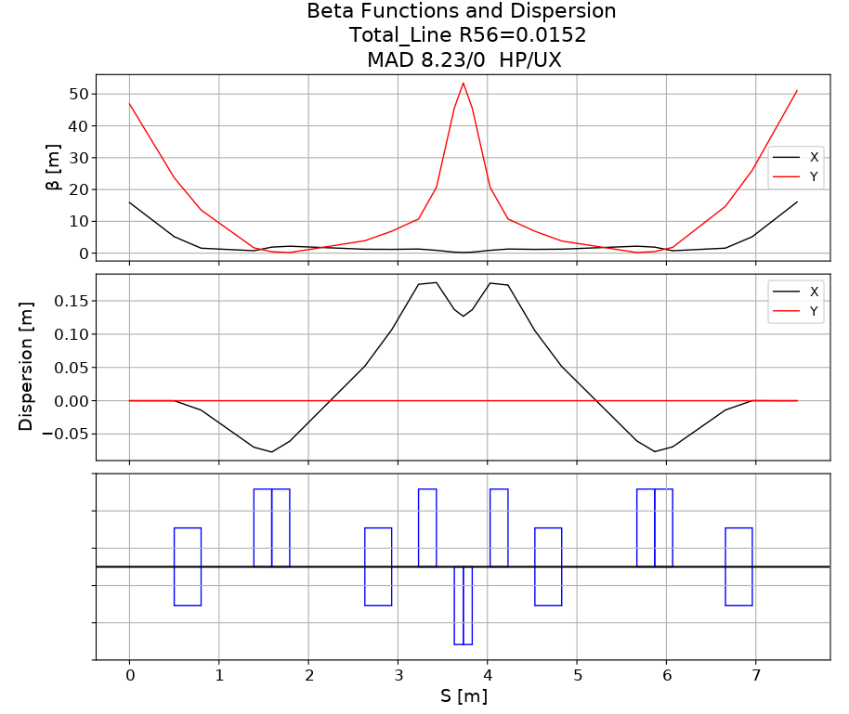
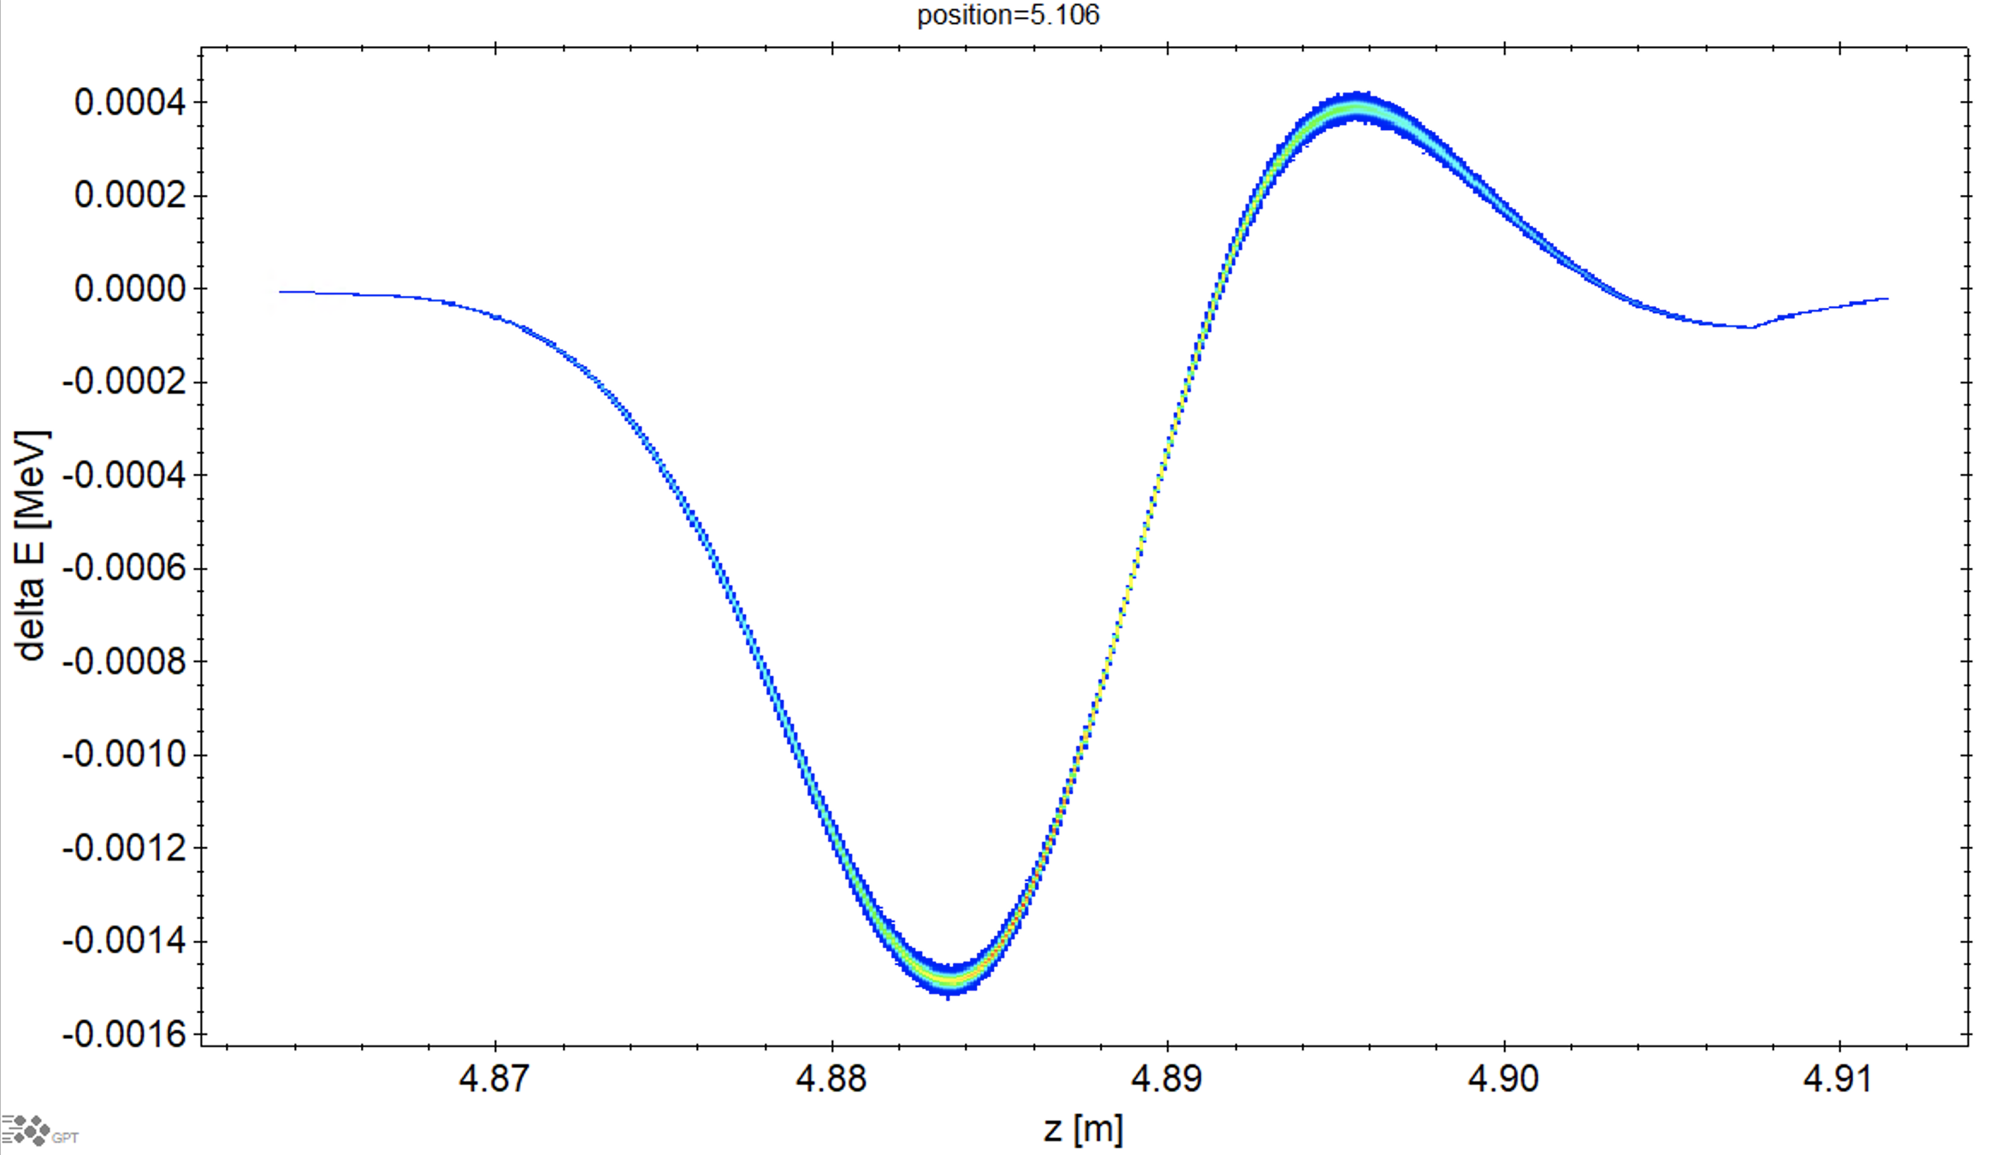
Amplification lattice
Total R56=0
Chicane R56 tunable
-4.3 to 1.8 cm
25 mm path lengthen
CSR simulation
On the chicane

Slide 19
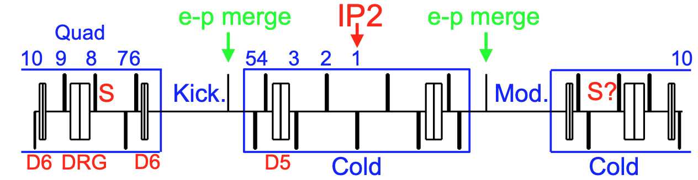
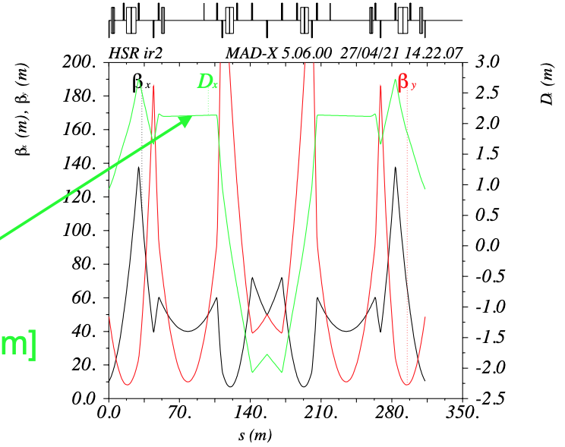
Hadron lattice
25 mm path lengthen
R56=-6.1, -2.2 mm
@ Steve Peggs

Slide 20
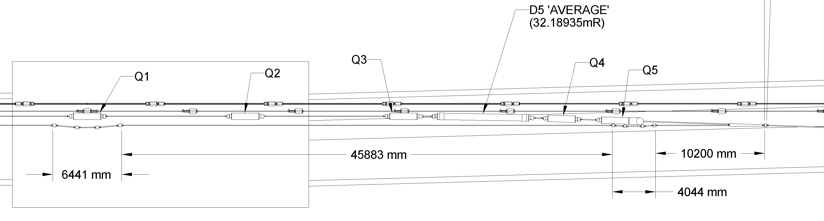
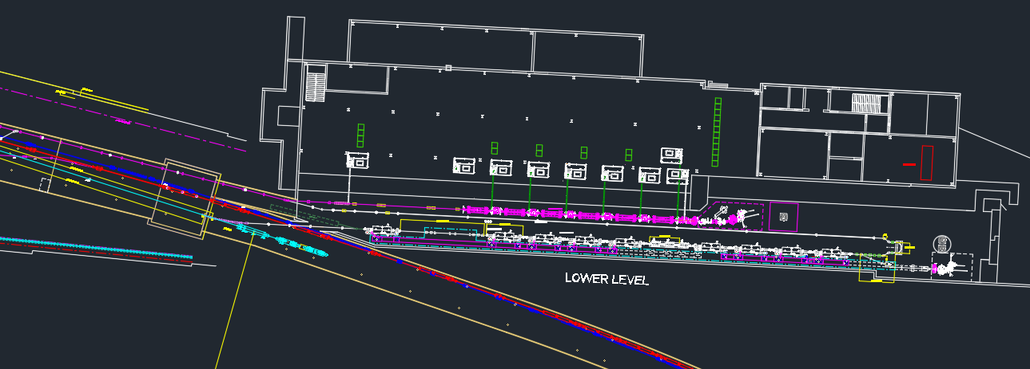

ERL layout
Amplification section
Gun to cooler
Return
Merge into HSR
Compression
LINAC
Injector

Slide 21

Summary of completed and ongoing tasks
MBEC theoretical study
1D cooling simulation tools development
Optimized cooling parameters
ERL and cooler conceptual lattice .
Gun to cooling section detailed design, full 3D simulation
Hadron lattice
Detailed cooler section lattice
Layout in IR2 and new source building

Slide 22
Design plan
3D cooling simulation.
Determine the cooler parameters.
Cooling diagnostics
ERL design:
  Detail lattice design in bmad: transverse/longitudinal matching, BBU, wake impedance, Tolerance
  Diagnostics
  Impact T/Z : Halo, beam noise
  CST, SF, Omega3P: Detail RF design, RF kick, HOM, Qext
  Engineering: PS, Vacuum, cryo
Planned to be continued in FY22
Planned to be continued in FY22
Planned to be continued in FY22

Slide 23
Thanks for your attention!

Slide 24
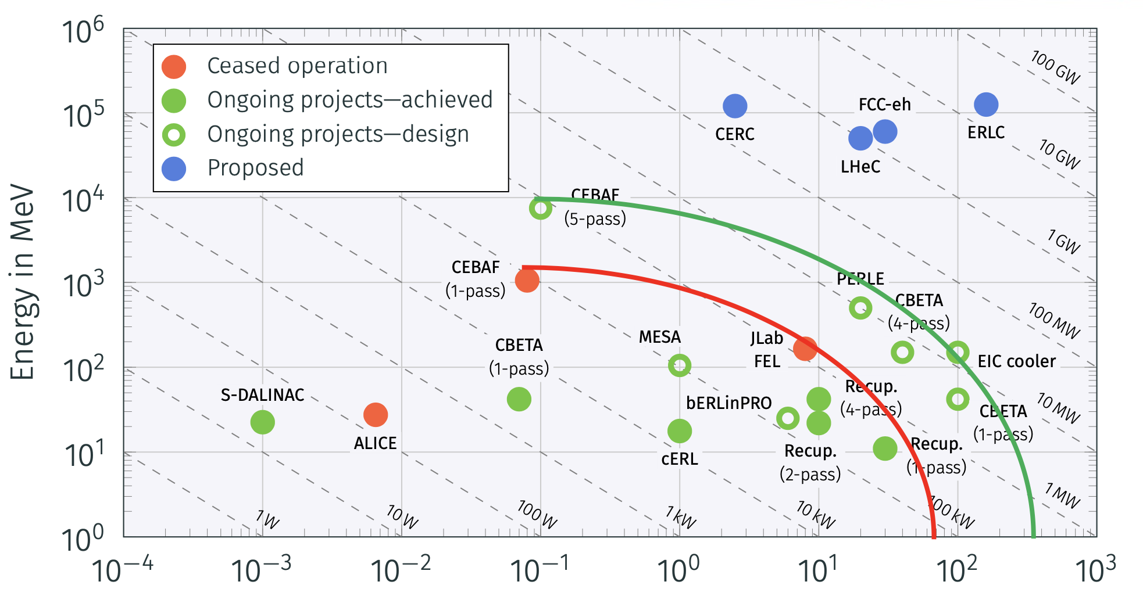
ERL summary
Average current in mA

Slide 25
Challenges and opportunities
CeC has not been experimentally demonstrated
Very low energy spread is required
Require: <10⁻⁴
- 2e-4 at LEReC; 1e-4 PAL XFEL
Very low shot noise from electron beam
- Laser heater LCLS; by optimizing optics at BNL
High current ERL
Require: 120 mA and 150MeV
- Jlab FEL 8 mA; Novo FEL 30 mA ( normal conducting )
High current high charge electron source
Require: 120 mA @1nC
Cornell 65 mA@ 60 pC; BNL 30 mA@100 pC
Beam diagnostics: beam noise, e-h alignment, energy spread measurement.
RHIC CeC experiment
GPT/Bmad simulation
IMPACT simulation
EIC components R&D
SHC R&D will push the frontier of accelerator science

Slide 26
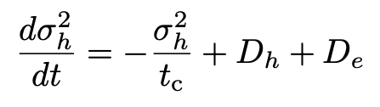
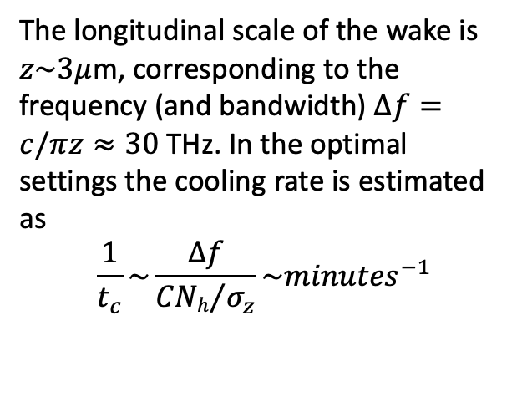


Energy kick (wake) in the kicker section
The longitudinal scale of the wake is
$z\sim 3μ$m, corresponding to the frequency (and bandwidth) $Δf=c/πz≈30$ THz. In the optimal settings the cooling rate is estimated as
$$\frac{1}{t_{c}}\sim \frac{Δf}{{CNh}/{σ_{z}}}\sim {minutes}^{−1}$$
Computed by
W. Bergan
$$E>E_{0}$$
$$E<E_{0}$$
Using this wake, we calculate the cooling time and the diffusion in the beam and use the kinetic equation for the evolution of the hadron distribution function.
D_{h} is due to noise in the hadron beam, D_{e} is due to noise in the electron beam
From G. Stupakov

Slide 27
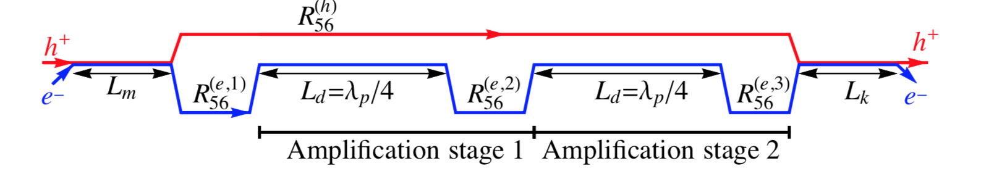
Strong Hadron Cooling for EIC Cooling for eRHIC
Requirements: eRHIC Peak Luminosity of 10³⁴cm⁻²s⁻¹ requires 6·10¹⁰ protons per bunch, 6 cm bunch length and small emittances of e_{x}= 9.2 nm, e_{y} = 1.3 nm ➔ beam subject to IBS, initial growth time of >2h in the hor. and long. direction
Method: Strong Hadron Cooling using coherent electron cooling with micro-bunched beams, bunching enhancement with 2 plasma amplification sections with a total of 3 bunching chicanes. Quarter of plasma wavelength as low as l_{p} =40 m
Cooling rate for short flat bunches ~1 h for longitudinal and transverse oscillations (theory & simulations)
Need an electron beam with 1nC bunches (100 mA CW) , dp/p~10⁻⁴ , normalized horizontal emittance ~2.5 mm-mrad

Slide 28
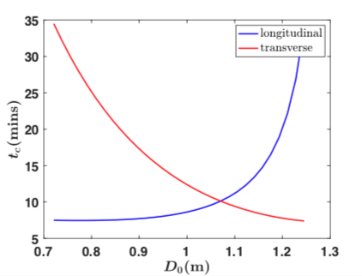
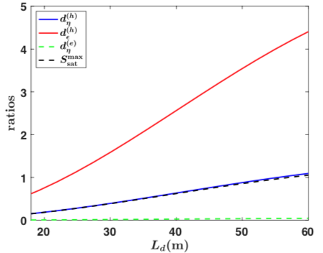
Various topics are addressed in theory
The cooling rate is derived in 1D model for the longitudinal degree of freedom and is optimized with respect to the chicane strength.
One and two amplification sections are studied and the cooling rate is obtained as a function of their parameters.
Control of the dispersion in the modulator and kicker re-distributes the cooling rates between the longitudinal and transverse degrees of freedom.
3D effects in cooling are analyzed. This analysis indicates that 1D model is a good approximation to a more realistic 3D one.
Effects of energy deviations in electron and hadron beams is studied and tolerances established for various energy profiles.
Noise effects and the associated heating process is taken into account. The cooling rate is maximized with account to the noise.
1D cooling simulation code is implemented in Matlab. Theoretical formulas are benchmarked against computer simulations.

Slide 29
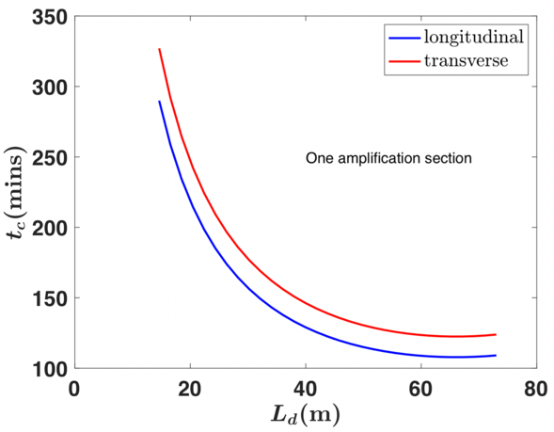
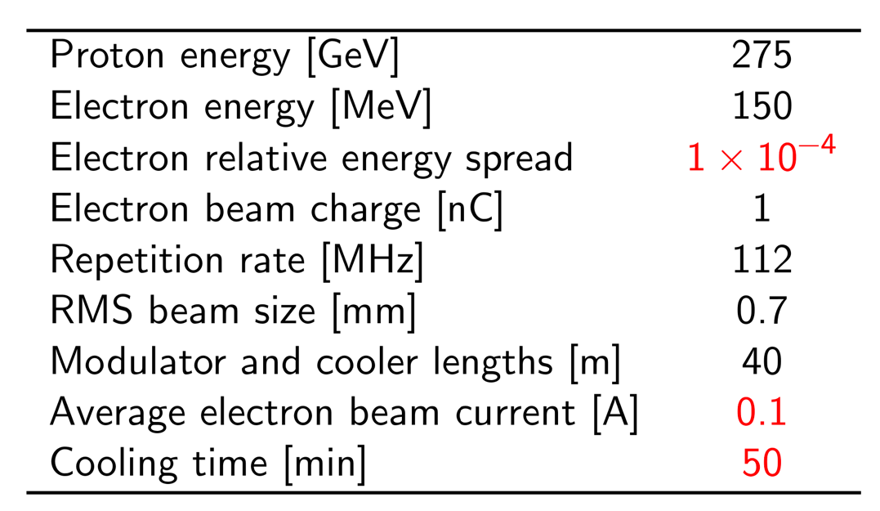
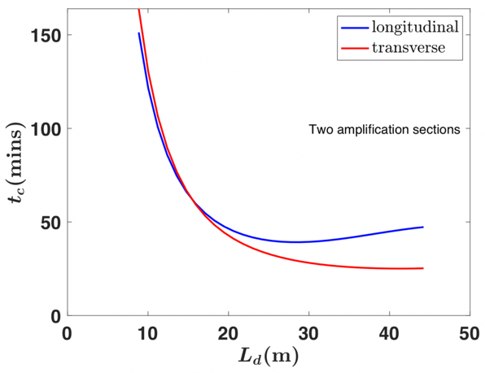
Conceptual parameters of the hadron cooler for EIC
﻿The electron bunch length, σ_{ze} =4mm, is much shorter than the proton bunch length, σ_{zh} =5 cm.
Two amplification sections, 20 m of each.
Cooling time as a function of the length of the amplification sections L_{d} for one (top) and two (bottom) amplification sections in the system.

