Slide 1
Synchrotron Light Source
Physics Department offer P518: Applications of Synchrotron Radiation.

Slide 2
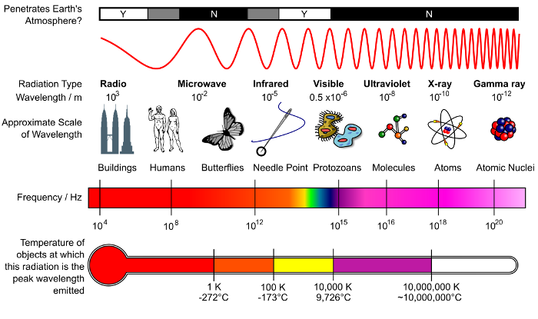
Radiation Spectrum

Slide 3
Wavelength and Photon Energy
The following relations are readily used:
1 angstrom hard x-ray, energy is 12.4keV
Visible light 500nm, energy is 2.4 eV

Slide 4
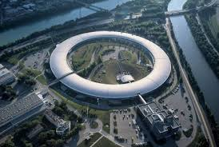
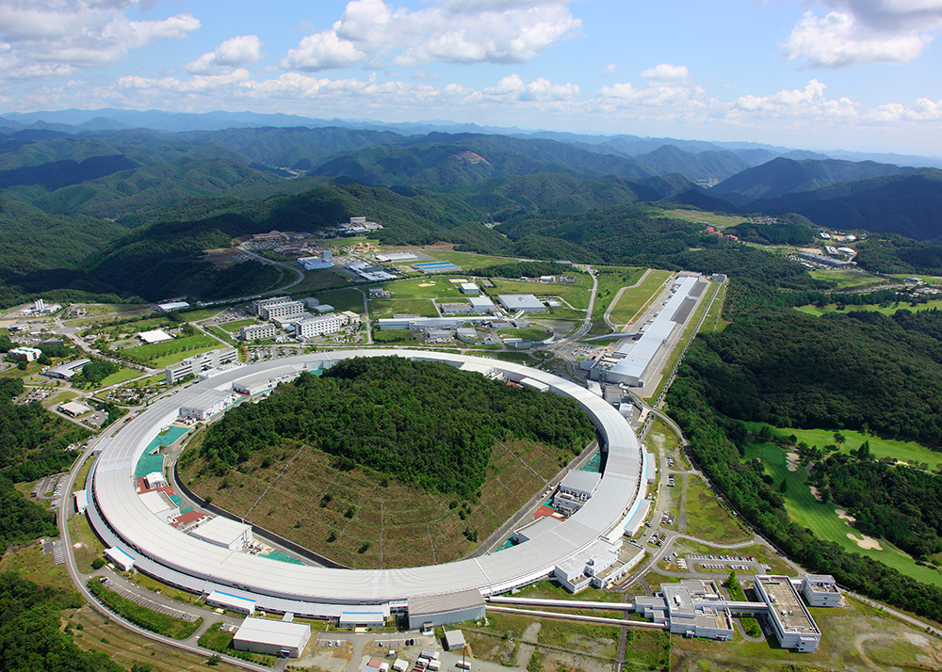
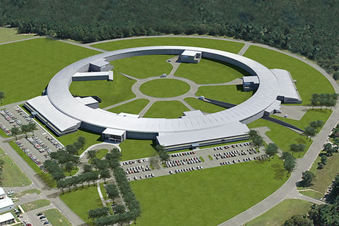
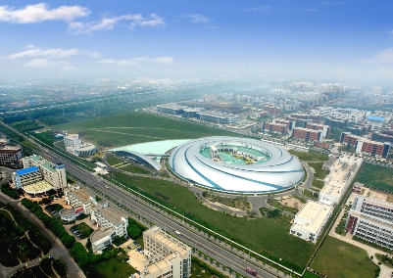
SR Light Source Worldwide
ESRF, 6 GeV
SPring-8, 8 GeV
NSLS II, 3 GeV
SSRF, 3.5 GeV

Slide 5
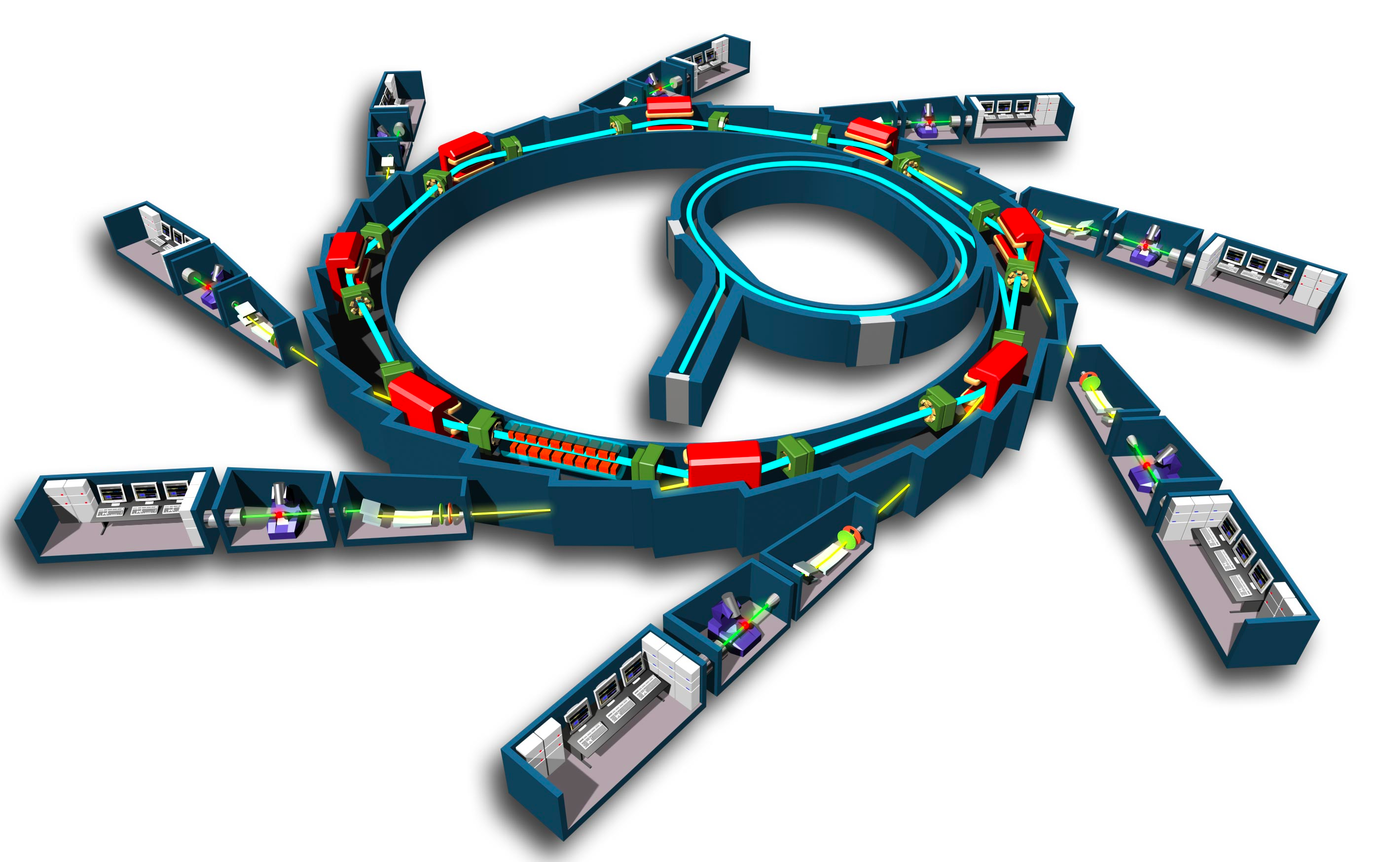
SR Light Source
To produce UV, (soft/hard) X-ray source
  Dipole, undulator/wiggler
EXCITING SCIENTIFIC TOOL.
LET LIGHT MEET MATTERS

Slide 6
Performance of light source
Brightness of photon
Flux
Notes:
B=\frac{d^4N}{dtd\Omega dS(d\lambda/\lambda)}

Slide 7
Higher Brightness Enable Us…
Process with less cross section
Trim the light for better
  Coherence, monochromatic radiation
Protein Crystallography
Spectroscopy with high resolution
Crystal Diffraction
Many More…

Slide 8
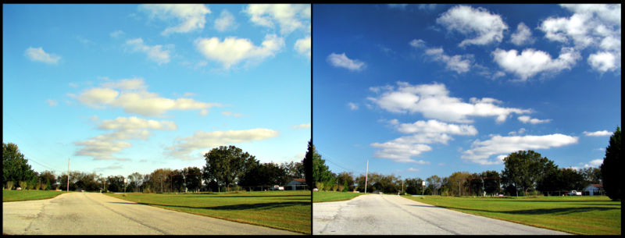
SR is polarized light

Slide 9
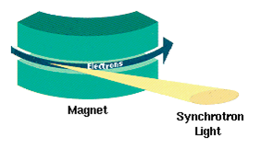
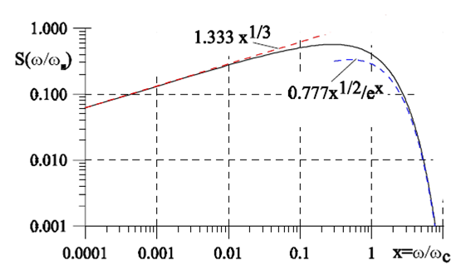
SR from Bending Magnet
Goods
  Simple, inexpensive
  Broad spectral range
  Many beamlines
Bads
  Limited hard x-ray components
  Not very bright

Slide 10
SR spectrum of Dipole, Energy Dependence

Slide 11
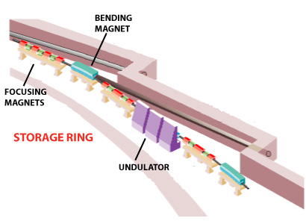
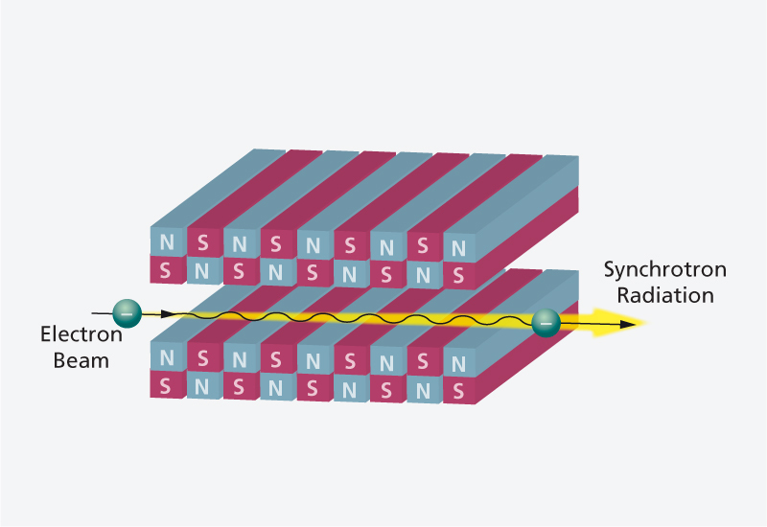
Undulator/Wiggler
In addition to the SR from dipoles, modern light sources has many long straight section with zero dispersion function.
They are undulators and wigglers with similar shape but different parameter.
Example: NSLS II
# of DBA cells: 30
# of 5m straights: 15
# of 8m straights: 15

Slide 12
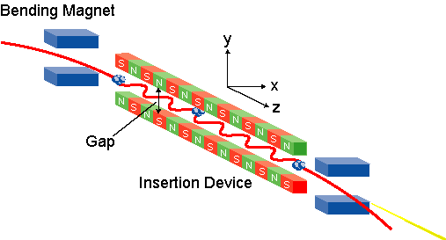
SR from Undulator/Wiggler
They are ‘insertion devices’ in straight sections. Modern accelerators provides many long straight sections.

Slide 13
Difference between bending magnet and Undulator/Wiggler
Courtesy of W. Barletta

Slide 14
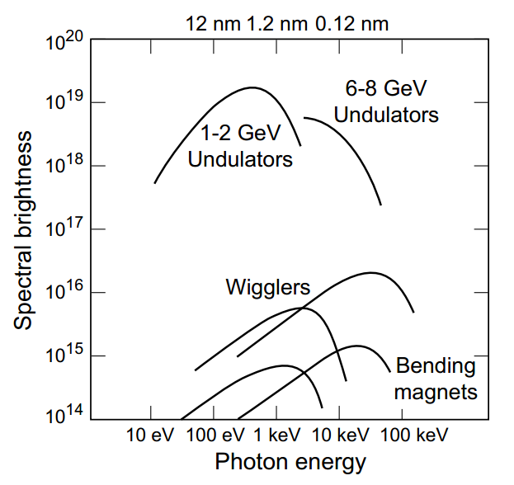
Brightness Comparison
Courtesy of W. Barletta

Slide 15
Electron Motion inside Undulator
Notes:
B=B_y=B_0\cos\frac{2\pi z}{\lambda_u}
\frac{dP_x}{dt}=ecB_0\cos\frac{2\pi z}{\lambda_u}
v_x=\frac{eB_0\lambda_u}{2\pi m\gamma}\sin\frac{2\pi z}{\lambda_u}\equiv\frac{Kc}{\gamma}\sin\frac{2\pi z}{\lambda_u}
K=\frac{eB_0\lambda_u}{2\pi mc}=0.934B_0[T]\lambda_u[cm]

Slide 16
Undulator ‘Slows down’ the electron
oscillating part is averaging to zero
As if the energy of beam changes:
Notes:
v_z=\sqrt{v^2-v_x^2}=c\sqrt{1-\frac{1}{\gamma^2}-\frac{K^2}{\gamma^2}\sin^2\frac{2\pi z}{\lambda_u}}
=c(1-\frac{1+K^2/2}{2\gamma^2}+\frac{K^2}{4\gamma^2}\cos\frac{4\pi z}{\lambda_u})

Slide 17
In electron ‘s rest frame
The electron sees contracted undulator
The frequency of the radiation is
In lab frame, the frequency of the radiation is different(relativistic Doppler Effect)
Notes:
f=\frac{f^\prime}{\gamma^*(1-\bar{\beta_z}\cos{\theta})}=\frac{c}{\lambda_u(1-\bar{\beta_z}\cos{\theta})}

Slide 18
Resonance Condition
The wavelength of the radiation in the lab frame:
Recall that:
And we only care of small forwarding angle:
Finally the wavelength reads:

Slide 19
Radiation for K<1
Radiation Bandwidth:
Angle for central cone
Courtesy of W. Barletta
Power:

Slide 20
Wiggler Radiation
When K>>1, the high harmonics become important and very dense.
The envelope is similar to the SR from dipoles. The brightness is increased by 2N

Slide 21
Beamline 101

