Slide 1
PHY 554
Fundamentals of Accelerator Physics
Lecture 12: Longitudinal Dynamics
Vladimir N. Litvinenko

Slide 2
6-D Phase Space
A complete description of a charged particle motion with respect to the ‘ideal particle’ must be done in 6D phase space.
Longitudinal dynamics is important in
  Storage rings
  Beam transport in linacs
  Applications, such as Free Electron Lasers

Slide 3
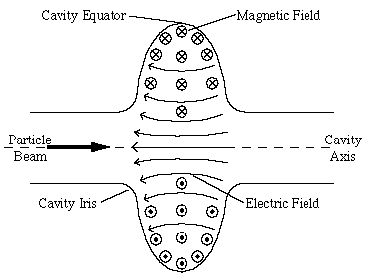
Charged Particle passing an RF Cavity
From previous lectures: Let us consider a ultra-relativistic particle passing a RF cavity, with the field E and voltage V.
The energy gain of one charged particle with position z in a bunch:
T(transit time factor)V
Notes:
E(s,t)=E_0(s)\sin(\omega t+\phi_s)
\Delta U=\int_{-\infty}^{\infty}E_0(s=ct+z)\sin(\omega t+\phi_s)cdt
\Delta U=e\int_{-\infty}^{\infty}E_0(s)\cos({ks})ds\times\sin(\phi)

Slide 4
Synchrotron Motion in a Storage Ring
Longitudinal motion in circular accelerators is called synchrotron motion
The origin of this term originates from “synchrotron” where particles are “synchronized” with oscillating electric field in RF cavity(ies)
  Similar to “betatron” motion name for transverse degrees of freedom, it is purely historical slang
Hence, the terminology is extended to synchrotron oscillations and synchrotron tune, Q_{s}, for stable oscillations
In contrast with transverse motion, where particles typically execute multiple oscillations per tur, synchrotron oscillations are usually very slow with Q_{s} <<1
The later is used for a simplified description of slow synchrotron oscillations by separating them from “fast” betatron oscillations

Slide 5
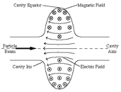
RF Synchronization in a ring
The frequency of the cavity must be integer harmonic of the revolution frequency:
Circumference:C
Revolution frequency:ω₀
h is called harmonic number.
h ideal particles can circulate in the ring.
They are called synchronous particles

Slide 6
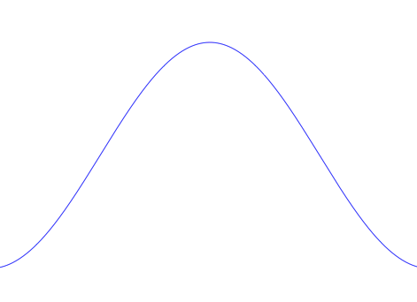
Charged Particle in RF Cavity II
We name the synchronous particle’s phase
For a number of good reasons we don’t want the particle to experience the highest accelerating voltage (on crest).
Notes:
\Delta U=eV\sin(\phi+\phi_s)

Slide 7
Energy change by the RF cavity
Synchronous particle energy change in the cavity is given by its synchronous phase
Non-zero value of energy change can be related to acceleration/deceleration of the beam or compensation for energy losses in the ring (such as radiation losses)
The energy of a particle displaced by distance z from synchronous particle changes as
Using relative values, we can re-write the above equations in dimensionless form
δ changes between n^{th} to (n+1)^{th} turn in the ring as:
Now we know, how the energy deviation evolves
Notes:
\Delta U=eV\sin(\phi)
\dot{U}=\frac{dU}{dt}=\frac{eV}{T}\cos(kz+\phi_s)
\dot{\delta}=\frac{eV}{TE_0}\cos(kz+\phi_s)
\delta_{n+1}-\delta_{n}=\frac{eV}{\beta^2E_0}(\sin\phi_n-\sin\phi_s)
\phi_n=\omega t_n+\phi_s=-kz_n+\phi_s

Slide 8
Revolution time of a particle
Let’s consider the consequence of the energy deviation
  Its velocity changes:
  And the pass length change
The arrival time difference
ρ
ds(1+ Dδ/ρ)
ds
ρ+Dδ
Notes:
\frac{\Delta v}{v}=\frac{1}{\gamma^2}\delta
\frac{\Delta C}{C}=\oint \frac{x(s)}{\rho}ds=\oint \frac{D(s)}{\rho}ds\delta=\alpha_c \delta

Slide 9
Change in RF phase
Then we can translate the arriving time to the rf phase variable:
Change to turn by turn mapping format:
Combined with the earlier change in the energy change, we have the longitudinal one-turn map:
Notes:
\Delta \phi=\omega \Delta t+\phi_s
{\color[rgb]{0.501961,0.000000,0.250980}\phi_{n+1}-\phi_{n}=}\omega T\eta\delta_{n+1}={\color[rgb]{0.501961,0.000000,0.250980}2\pi\eta\delta_{n+1}}

Slide 10
Fixed Points
For any nonlinear map the first step is attempt to find fixed point(s)
The fixed point is defined as:
And located at
Next step to find if fixed points are stable are not?

Slide 11
An Example
Consider the example with following parameter:
  Proton beam with 100 GeV or 15 GeV
  Cavity voltage 5 MV, 360 harmonic
  Compaction factor 0.002
  No net acceleration.
  Initial condition:

Slide 12
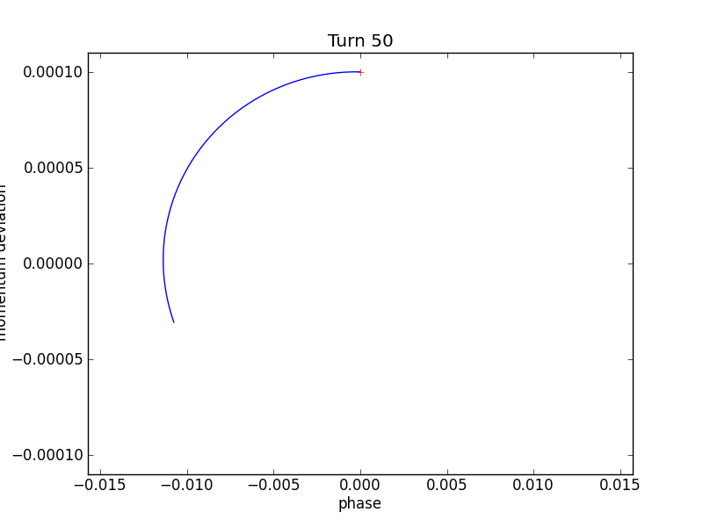
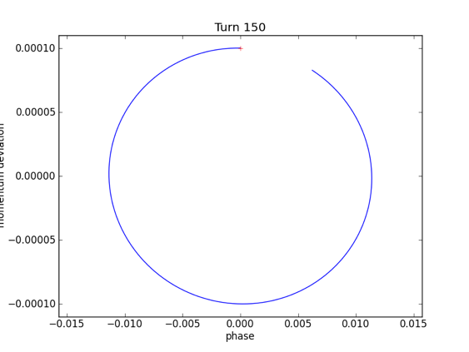
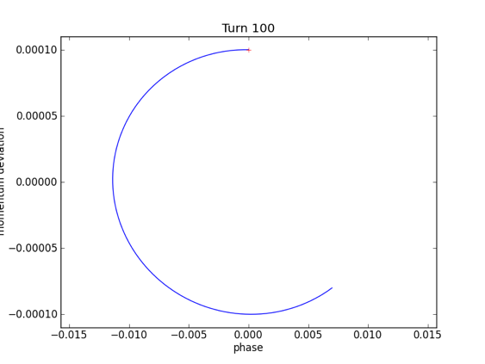
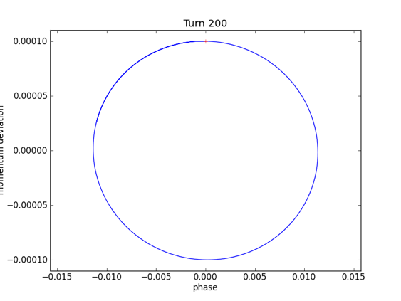
Phase stability for 15GeV

Slide 13
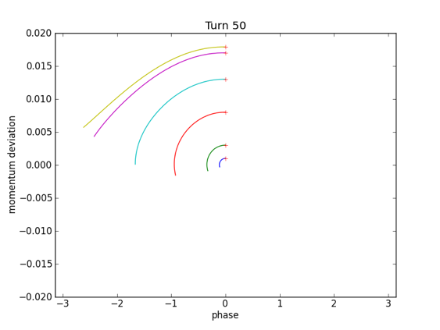
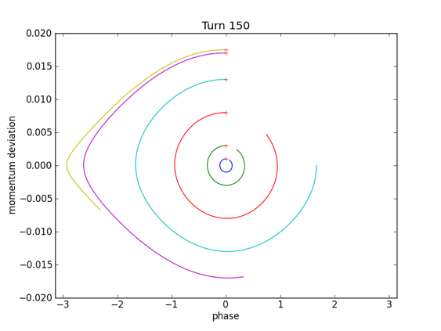
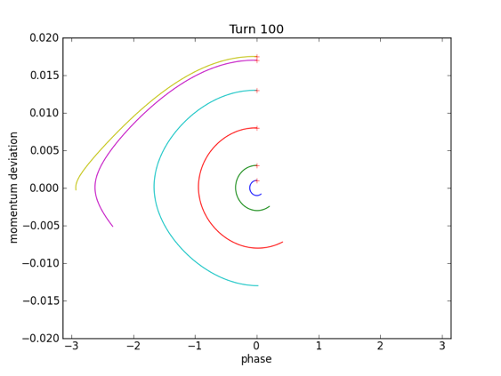
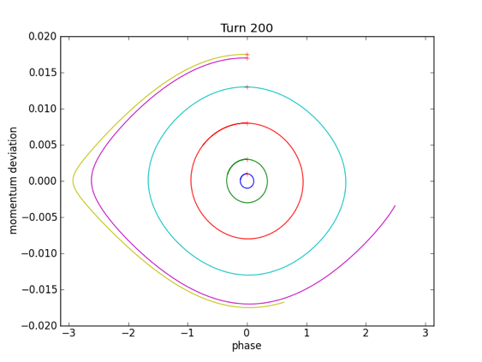
Phase stability, cont’d

Slide 14
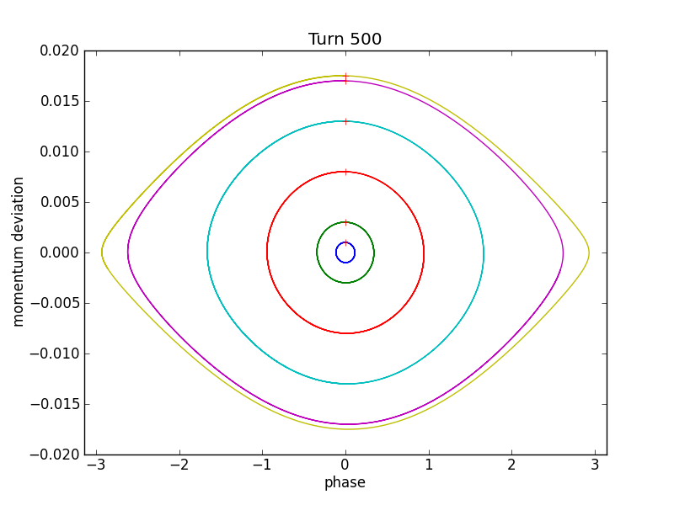
Phase stability cont’d

Slide 15
Phase stability cont’d

Slide 16
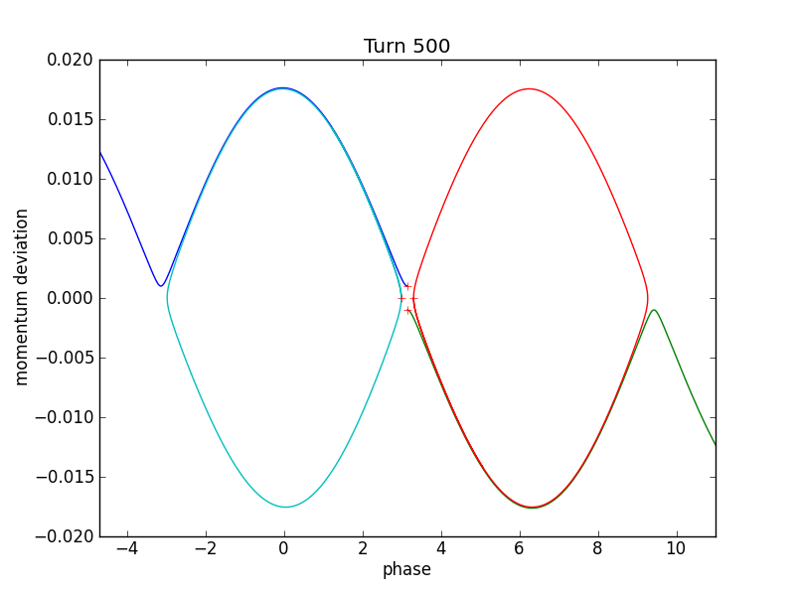
Phase stability, cont’d

Slide 17
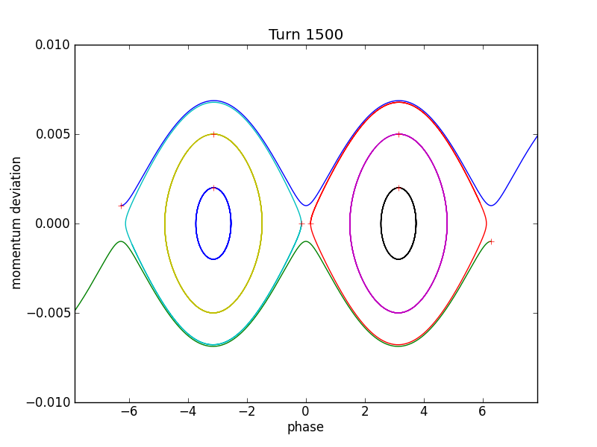
Phase stability for 100 GeV

Slide 18
From Map to Hamiltonian
Finite differential map:
Can be approximately described by differential equations when variations are small
with the turn number as independent variable and an effective Hamiltonian of a pendulum!
Notes:
\dot\delta=\frac{eV\omega_0}{2\pi\beta^2E_0}\left(\sin\phi-\sin\phi_s\right)
H=\frac{1}{2}h\omega_0\eta\delta^2+\frac{eV\omega_0}{2\pi\beta^2E_0}\left[\cos\phi-\cos\phi_s+\sin\phi_s\left(\phi-\phi_s\right)\right]
\ddot\phi=\frac{eVh\eta\omega_0^2}{2\pi\beta^2E_0}\left(\sin\phi-\sin\phi_s\right)

Slide 19
Similarity to pendulum
@ zero accelerating phase
‘MASS’
(not unique)
Stable phase
Bucket height
For stable motion
Angular frequency for small oscillation

Slide 20
Small amplitude approximation
Stability criterion
Back to the 2nd order differential equation
For small phase deviations we can linearize it
And find stability condition:
Notes:
\ddot{\Delta\phi}=\frac{eVh\eta\cos\phi_s\omega_0^2}{2\pi\beta^2E_0}\Delta\phi

Slide 21
Synchrotron tune
The ‘tune’ is extracted as
Synchrotron tune for zero crossing
Typical Numbers
  Hadron rings: Q_{s} ~ 10⁻³
  Electron rings: Q_{s} ~ 10⁻²
Notes:
Q_s=\sqrt{\frac{-eVh\eta\cos\phi_s}{2\pi\beta^2E_0}}\equiv\nu_s\sqrt{\left|\cos\phi_s\right|}
\nu_s=\sqrt{\frac{-eVh\eta\cos\phi_s}{2\pi\beta^2E_0}}

Slide 22
Small Amplitude Approximation
Hamiltonian
When the phase is close enough to the synchronous phase:
The phase space trajectory will be upright ellipse for fixed ‘energy’
Notes:
H=\frac{1}{2}h\omega_0\eta\delta^2+\frac{eV\omega_0\cos\phi_s}{4\pi\beta^2E_0}\Delta\phi^2
\left(\frac{\delta}{\left<\delta\right>}\right)^2+\left(\frac{\Delta\phi}{\left<\Delta\phi\right>}\right)^2=1
\frac{\left<\delta\right>}{\left<\Delta\phi\right>}=\sqrt\frac{eV\left|\cos\phi_s\right|}{2\pi h\left|\eta\right|\beta^2E_0}

Slide 23
Transition energy
Transition happens when:
Below transition: Faster particle arrives first
Above transition: Slower particle arrives first

Slide 24
Physics Picture
Above Transition
Below
Transition

Slide 25
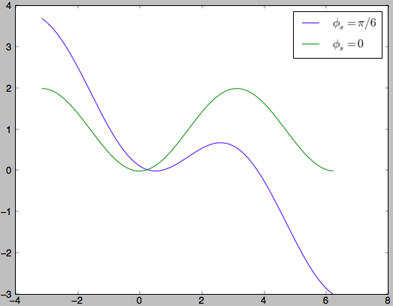
Non-zero acceleration phase
In lepton (electron & positron) storage rings, as well in future high (TeVs) energy hadron rings , we need acceleration for synchronous particle to compensate energy loss.
For now, we assume that the energy loss per turn is energy independent, and not net acceleration for synchronous particle.
Effective potential
Stable region

Slide 26
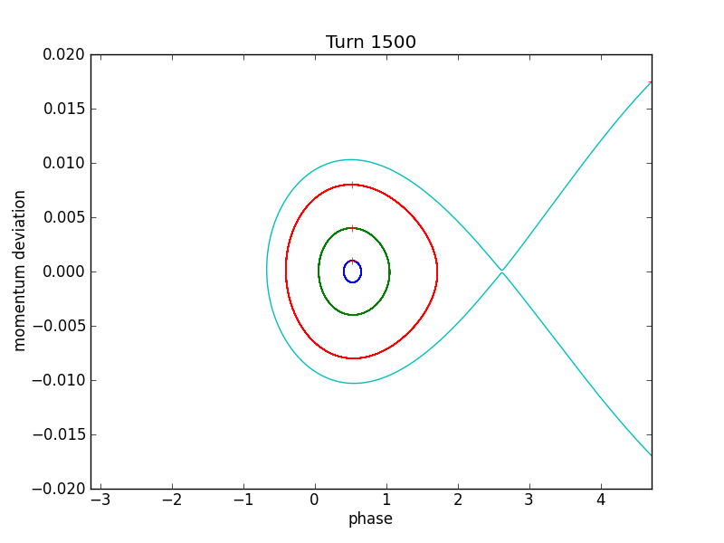
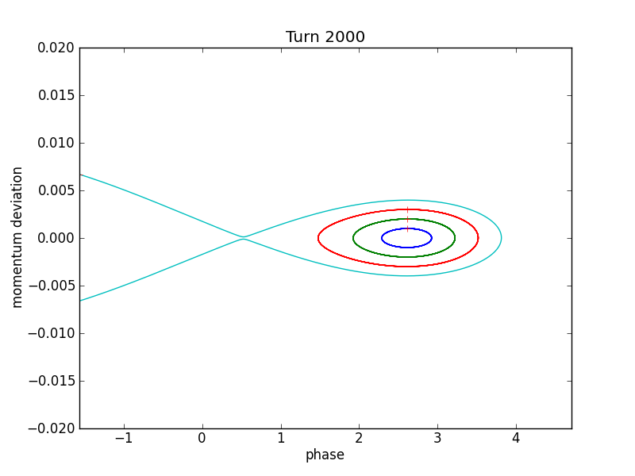
Phase space
15 GeV
100 GeV

Slide 27
Longitudinal Phase Space
We can define longitudinal phase space area from the conjugate variables.
The phase space area remain constant even in acceleration
If we stay with, , the phase space area is constant only without net acceleration.
Notes:
\left(t

Slide 28
Longitudinal Phase Space II
We may take a Gaussian beam distribution then the rms phase space area is simply:
The area is conserved only
  When the beam distribution matches the bucket
  When the beam oscillation is very small (linear).

Slide 29
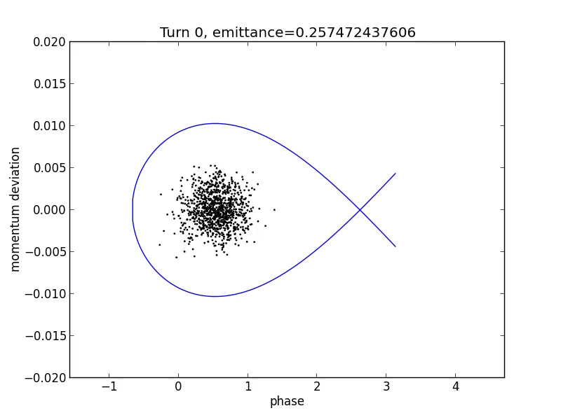
Phase Space Area
Examples and Evolution I
A Matched case
(Perfect injection):
Initial conditions match:

Slide 30
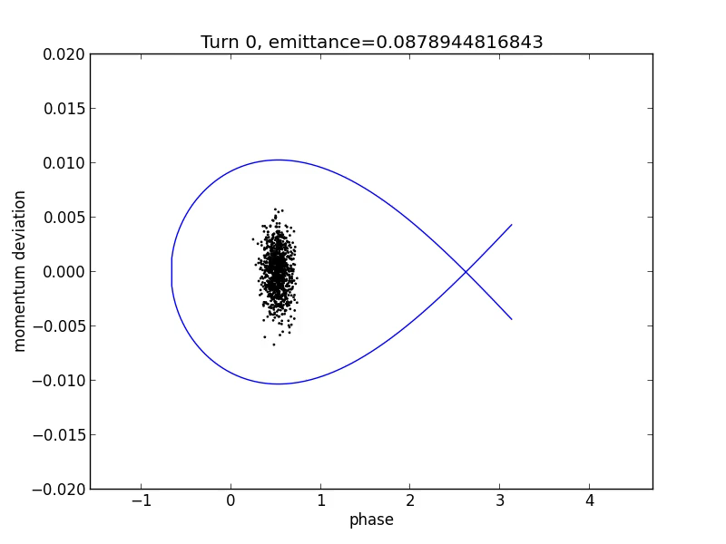
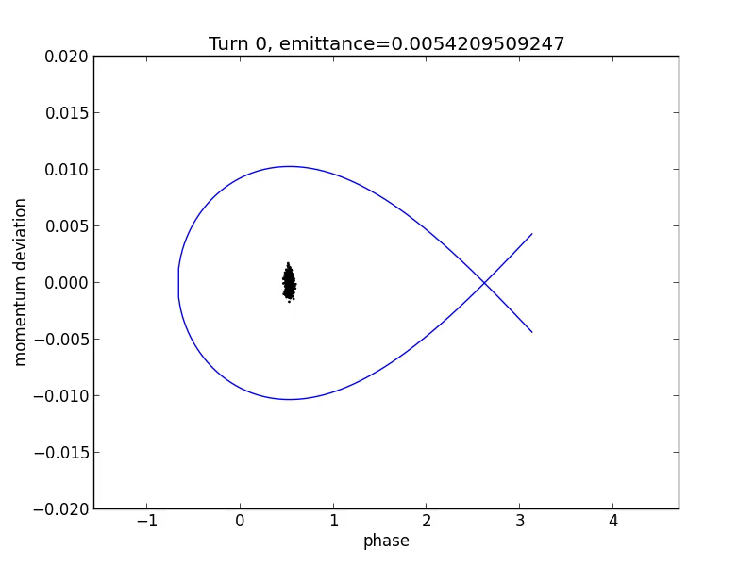
Phase Space Area
Examples and Evolution II
An unmatched case
Notes:
\frac{\left<\delta\right>}{\left<\Delta\phi\right>}=\frac{3Q_s}{h\left|\eta\right|}

Slide 31
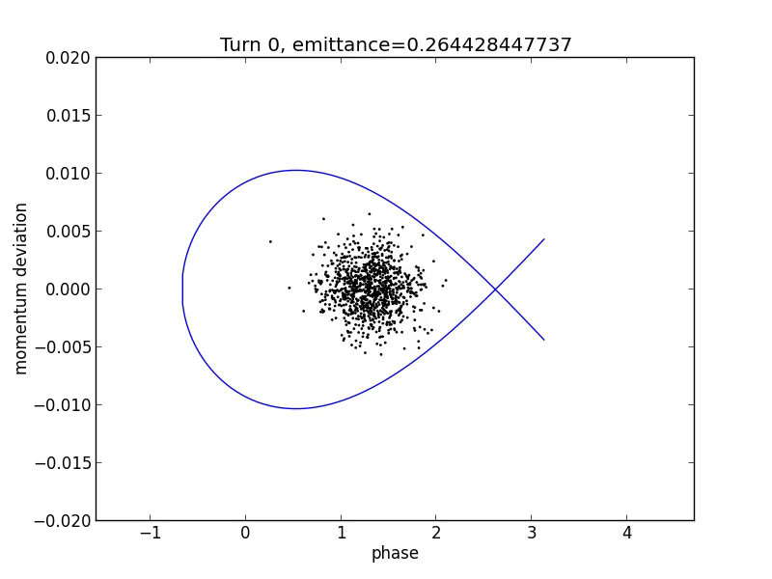
Phase Space Area
Examples and Evolution III
Time jitter at injection, other wise same as the matched case:
The phase error is:

Slide 32
What we learned today?
Stable longitudinal (e.g. energy – arrival time) motion of particles in circular accelerators is called synchrotron oscillations
Synchrotron motion is described with respect to a synchronous (ideal, or moving as designed) particle, which may experience acceleration, deceleration or energy loss by various processes such as radiation
RF frequency is a integer harmonic (h) of the synchronous particle revolution frequency and has to be adjusted if velocity of the beam changes
h bunches can be operated (accelerated) simultaneously in such storage ring/synchrotron. Area in energy-phase space for each bunch is called “RF bucket”
There two phases for synchronous particles in each RF bucket: one stable and one unstable (saddle)
Stable phase (positive or negative slope) depends on sign of the slip factor η. The slip factor depends on the particles energy: the energy where η crosses zero is called critical energy. Typically transition energy occurs when relativistic factor γ~Q_{x}
Crossing critical energy in accelerators is challenging and requires a number of sudden lattice modification to keep beam stable. Lepton ring are typically operate above the transition energy and do not have such complications
has time independent Hamiltonian (e.g. it is a constant!) and use the Hamiltonian contour plot as

Slide 33
What we learned today?
Accurate description of synchrotron motion is described by a map, e.g. change of the energy and the phase in finite differentials. Synchrotron oscillation have stability areas separated by trajectory (called separatrix) from area of unstable motion.
Synchrotron oscillations are typically very slow, Q_{s}<<1, which allows to describe them by differential equation identical that that of a pendulum. Such description has time independent Hamiltonian (e.g. it is a constant!) and use the Hamiltonian contour plot as particles trajectories in the phase space
When synchronous particles have zero energy change in RF cavity (no acceleration, no energy loss), separatrices a symmetric and particles outsize the separatrix acceptance are drifting in phase without being “lost”: particles with higher energy above the separatrix never cross to the lower part and vice versa.
E-E_{o}
t

Slide 34
What we learned today?
When synchronous particles gaining or losing energy, topology of the phase space changes: particles can cross from the upper part to the bottom part (typical for qn acceleration or a energy loss case) or from the bottom to top (for a deceleration case) – these particles will be lost by hitting energy acceptance of the lattice
Synchrotron oscillations are intrinsically nonlinear and asynchronous: oscillations with larger amplitudes are slower than at small amplitudes. Period turns into infinity at the separatrix: particle never reaches a saddle point.
Pair (-t, E) is a canonical pair and Liouville theorem guaranties preservation of the phase space occupied by particles
During injection of particles, phase and energy errors as well as mismatch of the particles distribution can lead to effective “emittance” growth by particles entrapping “empty space”. Asynchronousity of oscillations is the cause of this mixing.
E-E_{o}
t

Slide 35
Credits
This lecture is an updated version of 2016 lecture on the same subject prepared by Prof. Yue Hao (now at MSU)
The most important credit to Prof. Yue Hao are for the animations of the particle's motions in slides 29-31

